Slide 1





Material well-being of children in Bangladesh: Preliminary results from Children’s Worlds wave 3 survey
Dr Haridhan Goswami, Manchester Metropolitan University, UK
Dr M Ibrahim Khalil, Government BM College, Bangladesh
Professor Dr Bijoy K. Banik, University of Rajshahi, Bangladesh
20th June 2019
University of Nantes, France

Slide 2
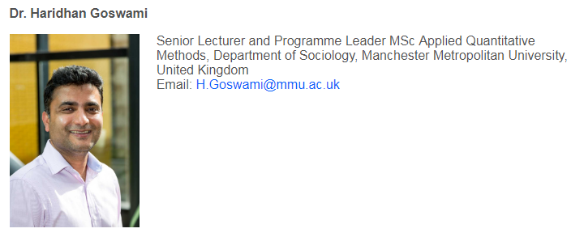
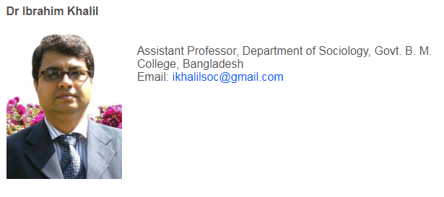
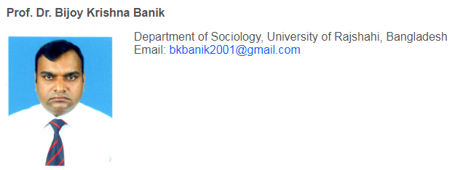
Research Team

Slide 3
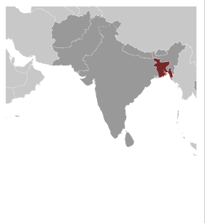
Bangladesh: Country profile

Slide 4
Bangladesh: Some general info
Key characteristics | Stat.
Year of independence | 1971
Population | 161 million
Ethnic groups | Bengali 98%; Other 2%
Religion | Muslim: 89%; Hindu: 10%; Other: 1%
Age distribution | 0-14 yrs.: 28%; 15-24: 20%; 25-54: 40%; 55-64: 7%; 65 and over: 6%
Urban population | 34%
Literacy rate (aged 15 and over can read and write) | 61%
Child labour (ages 5-14) | 13%
Unemployment (youth ages 15-24) | 9%
GDP | US$ 1,827

Slide 5
Structure of presentation
Reasons for conducting the survey in Bangladesh
Aims of the survey in Bangladesh
Specific objectives in today’s presentation
Methodology
Results
Areas for further development

Slide 6
Why this research in Bangladesh
  Research on child well-being in developing countries is lagging behind when compared with developed countries
  More research needed in cross-cultural comparative setting to better understand and explain variation in child well-being

Slide 7
Existing research and knowledge gaps: Indicator based
Begum and Sen (2009) | Maternal Health, Child Well-Being and Chronic Poverty: Does Women's Agency Matter? Bangladesh Development Studies
Malapit et al., (2015) | Gender Empowerment Gaps in Agriculture and Children’s Well-Being in Bangladesh. The International Food Policy Research Institute (IFPRI).
Emerson et al., (2016) | The Wellbeing of Children with Developmental Delay in Bangladesh, Bhutan, Laos, Nepal, Pakistan and Vietnam. An Analysis of Data from UNICEF’s Multiple Indicator Cluster Surveys.
Bangladesh Bureau of Stat. (2016) | Child well-being survey (2016) in urban areas of Bangladesh. UNICEF and BBS.
Uddin (2017) | Ecological Framework for Primary School Attainment in Ethnic Minority Children in Bangladesh. Child Indicators Research.

Slide 8
Child well-being research in Bangladesh: Policy context
Why in Bangladesh: Policy relevance
(A). United Nations Convocation on the Rights of the Child (UNCRC)
Article 12 (respect for the views of the child)
Every child has the right to express their views, feelings and wishes in all matters affecting them, and to have their views considered and taken seriously. This right applies at all times, for example during immigration proceedings, housing decisions or the child’s day-to-day home life.
Article 3 (best interests of the child)
The best interests of the child must be a top priority in all decisions and actions that affect children

Slide 9
Child well-being research in Bangladesh: Policy context
(B) Sustainable Development Goals (SDGs)
The 2030 Agenda for Sustainable Development, which includes 17 Global Goals, charts an ambitious course for the coming decade and beyond.
Attached to the goals are 169 targets, which lay out the specific aims towards which the global community is working. In total, 95 of the targets are either directly (48) or indirectly (47) connected to children.
The SDGs can only deliver on the promise of equity if the world knows which children and families are thriving and which are being left behind.
Understanding the situation of children in relation to the SDGs is crucial both for the wellbeing of children and for reaching the targets of the Global Goals.

Slide 10
Aims of the survey in Bangladesh
There are three main purposes of this survey in Bangladesh:
To collect solid data on Bangladeshi children’s lives and daily activities, their time use and, in particular, their own perceptions and evaluations of their well-being
To compare and contrast the lives of Bangladeshi children with those from other participating countries.
To help develop research informed child well-being policies in Bangladesh

Slide 11
Objectives of this presentation
  What is the material condition of living for children in Bangladesh?
  Does children’s assessment on material condition differ by their socio-demographic characteristics?
  How important is the material condition for children’s well-being in Bangladesh?

Slide 12
Methodology
Project phases: 2016-2019
  Pilot survey: June 2016 to December 2016
  Main survey: 2017 to 2019
  Data collection: January 2018 to March 2018
Ethics: Approval from Ethics Board of Manchester Metropolitan University
    Consent
    Anonymous
    Voluntary
    Privacy
    Data protection and security

Slide 13
Methodology
Data collection tool:
  Bengali version of Children’s Worlds questionnaire
  Translated into Bengali using back translation method
  Printed copies of questionnaire.
  3 versions of questionnaire:
    8 years old group (Class III in primary school)
    10 years old group (Class V in primary school)
    12 years old group (Class VII in secondary school)
  Students completed the questionnaires themselves in class-room settings
  Average time to complete questionnaire:
    40 minutes for 10 and 12 years
    50 minutes for 8 years group

Slide 14
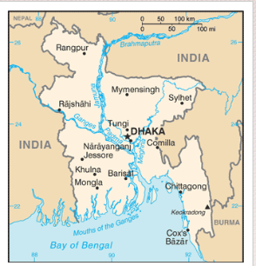
Fieldwork locations
Study area: 3 cities
    Rajshahi (city corporation area only)
    Barisal (city corporation area only)
    Moulvibazar (sadar thana only)

Slide 15
Methodology
    Sampling frame: All mainstream primary and secondary schools in those 3 areas.
    Sampling:
        Randomly selected schools
        Usually all children of targeted age groups from the randomly selected school
        If more than one section in the class, then random selection of one section
        If selected school is unisex, then next school was selected from opposite sex to maintain gender balance in the sample

Slide 16
Methodology
Sample school: Total 56 schools were selected out of which 36 primary schools and 20 secondary schools
Region | Primary schools |  | Secondary schools
 | Total schools | Sample schools | Total schools | Sample schools
Barisal (City corporation area) | 79 | 10 | 35 | 8
Moulvibazar (Sadar thana) | 189 | 15 | 25 | 5
Rajshahi (City corporation area) | 59 | 11 | 57 | 7
Total | 327 | 36 | 117 | 20

Slide 17
Methodology
Sample students: 3090 students from 3 regions (with the aim of at least 1000 from each location and each age group)
In this seminar, we will use data from year 10 and 12 only.
Region | Primary schools |  | Secondary schools
 | Year 8 | Year 10 | Year 12 | Total
Barisal | 350 | 352 | 361 | 1063
Moulvibazar | 341 | 330 | 351 | 1022
Rajshahi | 340 | 332 | 333 | 1005
Total | 1031 | 1014 | 1045 | 3090

Slide 18
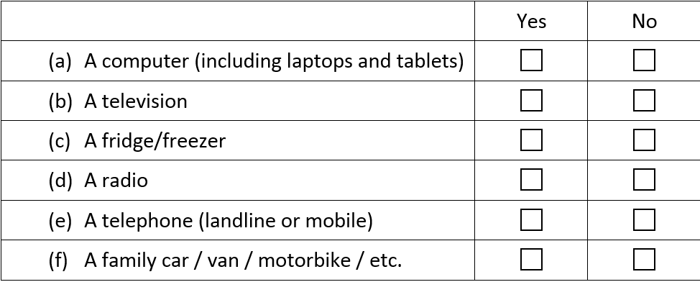
Measures of material well-being
To measure family economic status : 6 items
Which of the following does your family have at home:

Slide 19
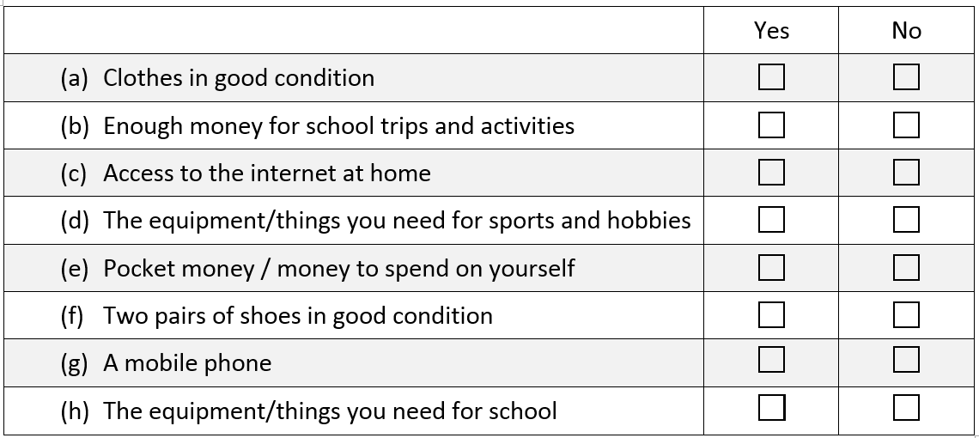
Measures of material well-being
To measure material deprivation (child’s individual access to 8 items):
Which of the following do you have:

Slide 20
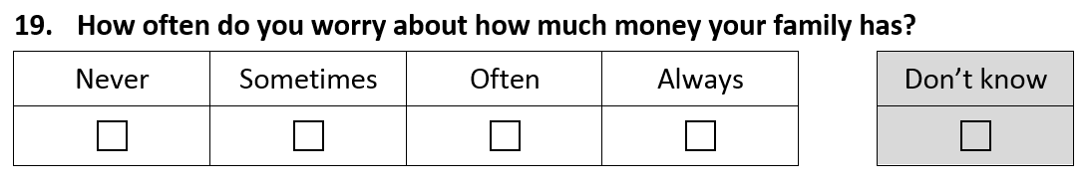
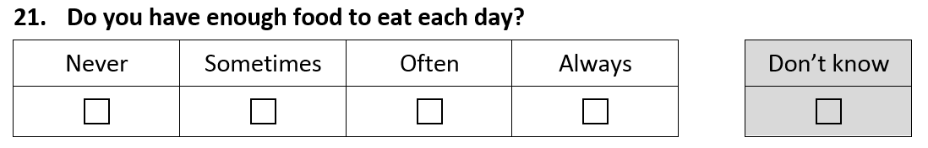
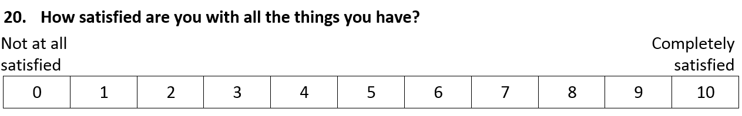
Measures of material well-being
Some other measures:
Worry about money
Enough food to eat
11 point scale

Slide 21
Measure of well-being: CW’s 6 item SWBS
Table-1 Factor loading scores
Internal consistency of items: Cronbach’s Alpha value = 0.88
Scale items | Factor scores
My life is going well | .837
I have a good life | .826
I like my life | .799
I am happy with my life | .798
I enjoy my life | .785
The things that happen in my life are excellent | .751
% of total variance explained | 63.99

Slide 22
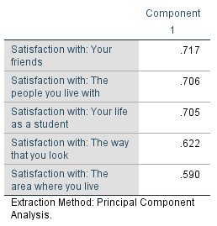
Measure of well-being: domain based 5-item SWBS
Table-1 Factor loading scores
Internal consistency of items: Cronbach’s Alpha value = 0.68

Slide 23
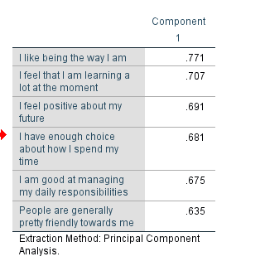
Measure of well-being: 6-item psychological well-being scale
Table-1 Factor loading scores
Internal consistency of items: Cronbach’s Alpha value = 0.78

Slide 24
  Results

Slide 25
Background characteristics of the children
  11.8 years (sd. = 1.3 year)
  55% girl
  74% lives in town
  98% live with their own family
  61% both parents; 27% extended; 9% only mother
  85% Muslim, 14% Hindu, 1% other
  98% Bengali, 2% other

Slide 26
  Material condition of living in Bangladesh: Through the lenses of children

Slide 27
Family economic status

Slide 28
Material deprivation
% of children said NO to the following

Slide 29
Worry about family money

Slide 30
Have enough food to eat each day

Slide 31
Eleven point scale measuring children’s satisfaction with things they have

Slide 32
  Children’s assessment of material condition by their socio-demographic characteristics

Slide 33
Assessment of material condition by (1) age groups

Slide 34
Assessment of material condition by (2) gender

Slide 35
Assessment of material condition by (3) rural-urban living

Slide 36
Assessment of material condition by (4) home type

Slide 37
Assess. material condition by (5) religious minority status

Slide 38
Assess. material condition by (6) ethnic minority status

Slide 39
Assess. material condition by family type

Slide 40
  Material condition and children’s well-being Bangladesh

Slide 41
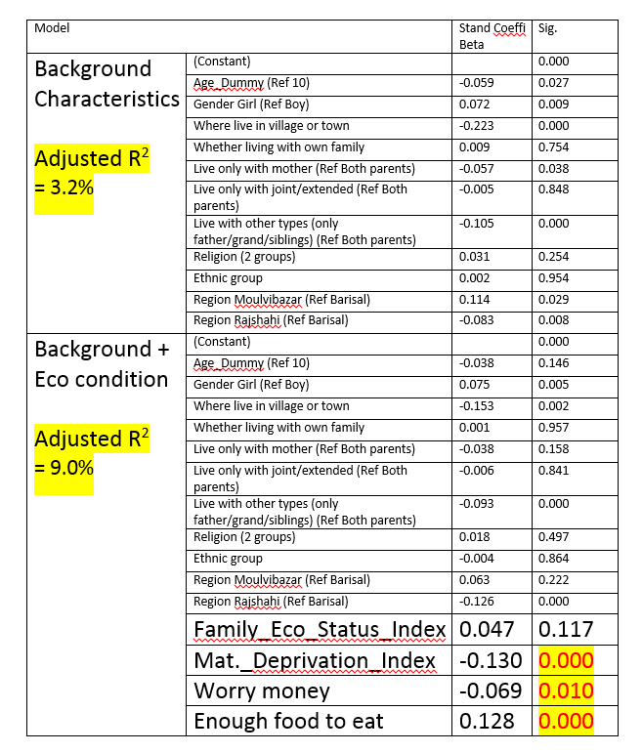
Economic condition and CW’s 6 item SWBS

Slide 42
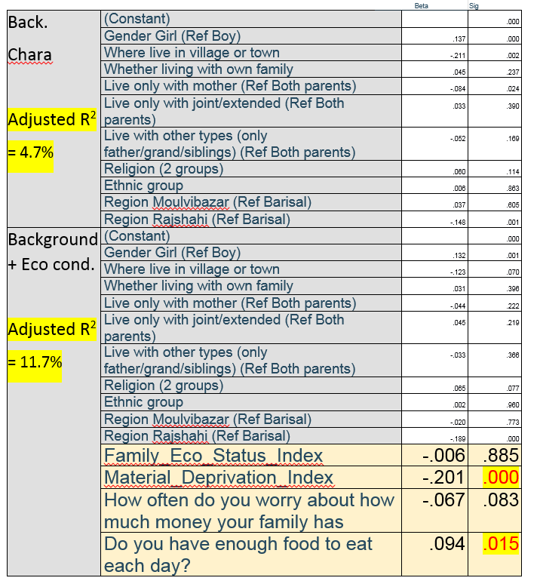
Economic condition and psychological well-being

Slide 43
Some emerging patterns!
  Overall material conditions:
  Overall, children are satisfied (48% totally satisfied; mean 8.27) with the things they have.
  However, almost 20% are unhappy (scored less than 5) with the things they have.
  Looking at individual indicator of material condition, 7 out of 10 worry about family finance. One-quarter of children reported not to have enough to eat every day.

Slide 44
Some emerging patterns!
  Material conditions by background characteristics
  Children’s assessment on material condition does not seem to vary by gender and age
  Assessment on material condition seems to differ by
      Rural-urban living
      Home type
      Religious minority status
      Ethnic minority status
      Family type

Slide 45
Some emerging patterns!
  Material conditions and well-being
  Material conditions play key roles in children’s overall well-being
      6% additional variation explained by material conditions in subjective well-being scale
      7% additional variation explained by material conditions in psychological well-being scale

Slide 46
Limitations and direction for future
  This survey only focuses on children from mainstream school. English medium, faith based (madrasha), English version
  Children in marginal groups: those not going to school, street children, water gypsy children, climate refugee children, ethnic minority children
  Reliability and validity of measures for younger age group (e.g., 8 years) are not assessed.

Slide 47
  Thank you
  Contact details:
  Dr Haridhan Goswami. E-mail: H.Goswami@mmu.ac.uk
  Dr M Ibrahim Khalil. E-mail: ikhalilsoc@gmail.com
  Professor Dr Bijoy K. Banik: bkbanik2001@gmail.com

