Slide 1

Children’s Worlds
The International Survey of Children’s Well-Being
The Project Status
June 2019

Slide 2
Topics:
An historical view on the project
The current wave status
The near future

Slide 3
The Project’s Phases
First pilot 2010
First wave 2011-2012
Second wave
2013-2104
Third wave
2017-2019
Planning 2009
Conducting the survey in more than 40 countries, until now among 90,000 children, using representative samples
Conducting the survey in 14 countries among 33,000 children ages 8, 10 & 12, Using convenience sample
Developing a questionnaire, supported by UNICEFF
The questionnaire was tested (twice) in 9 countries, among
10,000 children
Conducting the survey in 18 countries, among 60,000 children, using representative samples
Notes:
The project began in 2009 when a group of researchers, mainly from the International Society for Child Indicators (ISCI), held a meeting hosted by UNICEF to discuss the potential need for the survey. The group agreed that such a survey would fill an important gap in knowledge internationally about children’s lives. One of the products of the meeting was an early version of a survey questionnaire. This first draft questionnaire was tested and piloted in the summer and autumn of 2010 in the following countries. In December 2010, the findings of these pilot surveys were presented and discussed, under the auspice of World Vision - Germany, and this led to a second draft version of the questionnaire which was then piloted in the first half of 2011 in Germany, Romania, South Africa Spain and Turkey. In October 2011, members of the research group reviewed the learning from the second pilot and drew up a third set of the survey questionnaires with separate versions for children aged 8, 10 and 12.

Slide 4
Jacobs Foundation, Zurich
“The Jacobs Foundation invests in the future of young people so that they become socially responsible and productive members of society. In order to achieve this goal, children and youth must be given better opportunities for positive development and equitable access to education. Whatever their background, place of residence or family income, all children should have the chance to reach their full potential.”
Founded in 1989
Foundation assets: 4,5 MRD Swiss Franc
https://jacobsfoundation.org/en/

Slide 5
Jacobs Foundation, Zurich
Science of Learning
Early Childhood
Rural Livelihoods

Slide 6
Participants per Country
First Wave
Algeria | 1,450
Brazil | 2,298
Canada | 383
Chile | 2,558
England | 1,141
Israel | 2,973
Nepal | 253
Romania | 3,296
Rwanda | 295
South Africa | 1,002
South Korea | 7,973
Spain | 5,727
Uganda | 2,035
USA | 1,799
Total | 33,183
Second wave
Algeria | 3,676 | Nepal | 2,953
Colombia | 2,816 | Norway | 2,864
Estonia | 3,118 | Poland | 3,157
Ethiopia | 2,877 | Romania | 4,104
Finland | 2,842 | South Africa | 3,188
Germany | 3,009 | South Korea | 7,467
Israel | 2,800 | Spain | 3,756
Italy | 3,701 | Turkey | 3,024
Malta | 2,584 | UK | 3,298
Total 61,234
Total no. of children 94,417
from 24 countries

Slide 7
Countries of The Third Wave (41!)
Albania
Algeria
Argentina
Taiwan
Vietnam
Switzerland
Sri Lanka
Vietnam
Spain
South Korea
South Africa
Russia
Romania
Portugal
Poland
Norway
Nepal
Namibia
Malta
Malaysia
Ivory Coast
Italy
Belgium
Israel
Ireland
Indonesia
India
Hong Kong S.A.R
Greece
Germany
France
Finland
Estonia
Chile
Bangladesh
USA
England
Brazil
Croatia
Hungary
Wales
China

Slide 8
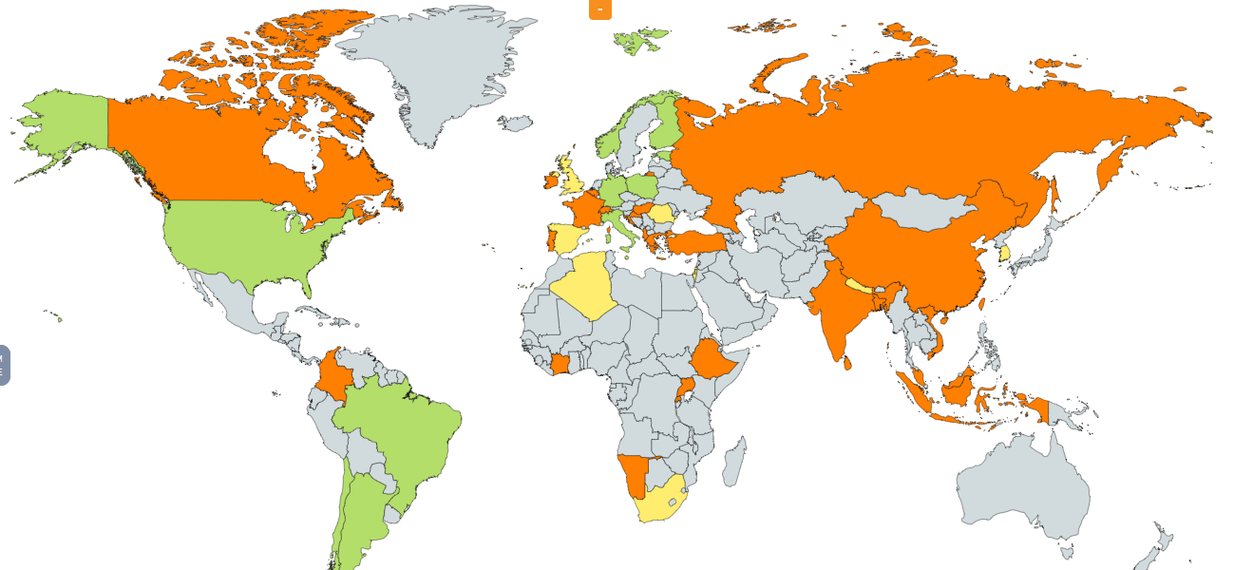
Children’s Worlds World Map
One wave
Two waves
Three waves
47 countries in all three waves
70% are developed countries and 30% are developing countries
From 5 continents

Slide 9
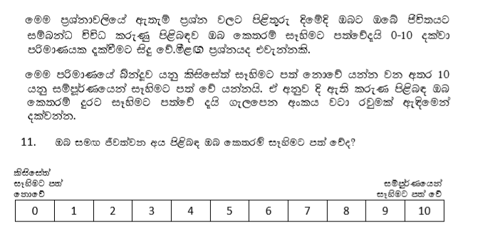
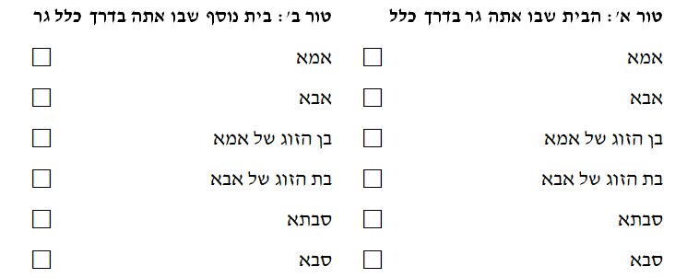
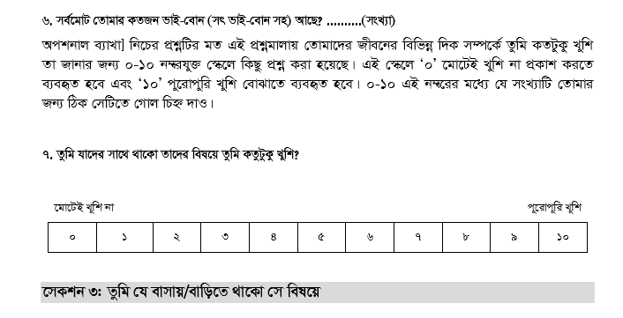
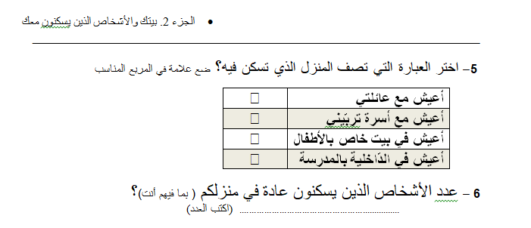
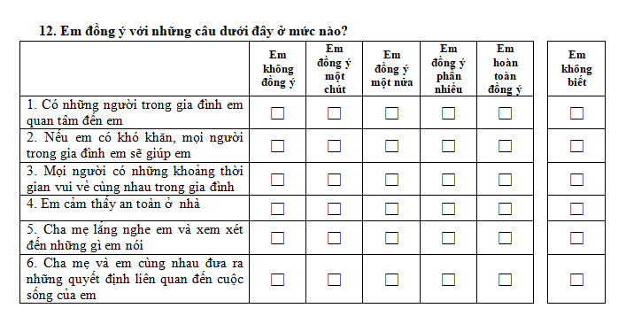
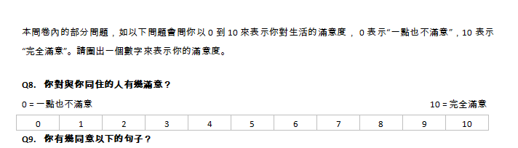

Slide 10
The Third Wave Status: Two Phases of Data Collection
1 Albania | 12 Malaysia
2 Algeria | 13 Malta
3 Bangladesh | 14 Nepal
4 Belgium | 15 Norway
5 Estonia | 16 Poland
6 France | 17 South Africa
7 Germany | 18 South Korea
8 Greece | 19 Sri Lanka
9 India | 20 Taiwan
10 Indonesia | 21 Vietnam
11 Israel | 22 Wales
Data collection has been completed including data cleaning and weighting among 22 countries
1 Argentina | 12 Portugal
2 Brazil | 13 Romania
3 Chile | 14 Russia
5 Croatia | 15 Spain
6 Finland | 16 Switzerland
7 Hong Kong S.A.R | 17 Turkey
China | 18 England
8 Hungary | 19 USA
9 Ireland
10 Italy
11 Ivory Coast
12 Namibia
Data collection will end soon (until the 15th of July)

Slide 11
Our Sample (after data cleaning)
 | 8yo | 10yo | 12yo | All
Albania | - | 1176 | 1163 | 2339
Algeria | 1185 | 1137 | 1054 | 3376
Bangladesh | 241 | 946 | 1012 | 2199
Belgium | 1134 | 1112 | 1076 | 3322
Estonia | 1058 | 1013 | 1079 | 3150
France | - | 2184 | - | 2184
Germany | 945 | 829 | 1524 | 3298
Greece | - | 822 | - | 822
India | 994 | 946 | 977 | 2917
Indonesia | 7444 | 7680 | 7999 | 23123
Israel | 1487 | 1637 | 1465 | 4589
Malaysia | 967 | 994 | - | 1961
Malta | 567 | 648 | 752 | 1967
Nepal | - | 1004 | 1041 | 2045
Norway | 604 | 801 | 817 | 2222
Poland | 974 | 1195 | 1157 | 3326
South Africa | - | 3415 | 3699 | 7114
South Korea | 3170 | 3203 | 3432 | 9805
Sri Lanka | - | 1154 | 1221 | 2375
Taiwan | 1342 | 1356 | 1532 | 4230
Vietnam | 930 | 946 | 1080 | 2956
Wales | - | 959 | 1668 | 2627
Total | 23042 | 35157 | 33748 | 91947
4,256 children have been deleted during data cleaning

Slide 12
Scope of the Samples
24 countries - a representative national sample
17 countries - a representative sample of one region/bit city
Algeria | West Algeria | Ireland | Cork
Argentina | Buenos Aires | Italy | Liguria Region
Belgium | Flanders | Nepal | Province No. 3
Brazil | South and southeast | Russia | Tyumen region
Chile | Concepción and Santiago | Spain | Catalonia
China | Guangdong | Sri Lanka | 3 regions
France | Nantes, Paris and Rouen | USA | South Dakota, Ohio, Maryland, Kentucky
Greece | the periphery of Epirus | Vietnam | North Vietnam
India | Kolkata

Slide 13

On-line Questioners
10 countries used on-line questioners
The rest used paper questionnaires
Belgium | Qualtrics
England | Qualtrics
Germany | Limesurvey
Greece | Qualtrics
Malta (12y) | Qualtrics
Norway | Qualtrics
Poland | Qualtrics
Taiwan | Qualtrics
Finland | Qualtrics
Wales | Qualtrics
Notes:
http://serveisfep.udg.edu/formularis/view.php?id=74221

Slide 14
Special Focuses
Children’s in out of home placement
(for example, Israel, Spain, Taiwan)
Children with disabilities
(for example, Israel, Romania, France)
Younger children (6 years old)

Slide 15
The Survey Plan
Details | Time
Data cleaning and weighting for all 22 countries who have submitted their data has finished until November 15th. The cleaned and weighted version was sent to the countries | November 2018
Preparing the international database for the 10 years old | December 2018 - February 2019
The international database for 10 years old has been sent to all the countries who already submitted their data | End of February 2019
Nantes meeting | 19th-20th, June 2019
The last data for data submission | July, 15th 2019
ISCI conference in Estonia | August 2019
Data cleaning and data weighting for the additional countries | August – October 2019
The second and final version of the international database for all age groups will be ready and will be sent to all the countries | December 2019
The final report of the project will be published and launched | January 2020
.

Slide 16

The core group:
Asher Ben-Arieh: asher@haruv.org.il
Bong Joo-Lee: bongjlee@snu.ac.kr
Ferran Casas: ferran.casas@udg.edu
Gwyther Rees: gwyther.rees@york.ac.uk
Jonathan Bradshaw: jonathan.bradshaw@york.ac.uk
Sabine Andresen: S.Andresen@em.uni-frankfurt.de
Hanita kosher: hanita.kosher@mail.huji.ac.il

