Slide 1
Children’s Worlds Project
Children’s Views on and Perception of Safety
Prof Dr Arbinda Lal Bhomi
Nepal

Slide 2
Presentation Outline
Sampling strategy
Children’s views on and perception of
- Safety at home
- Safety at school
- Safety on the way to and from school
- Safety at local area
Conclusion

Slide 3
Sampling Strategy

Slide 4
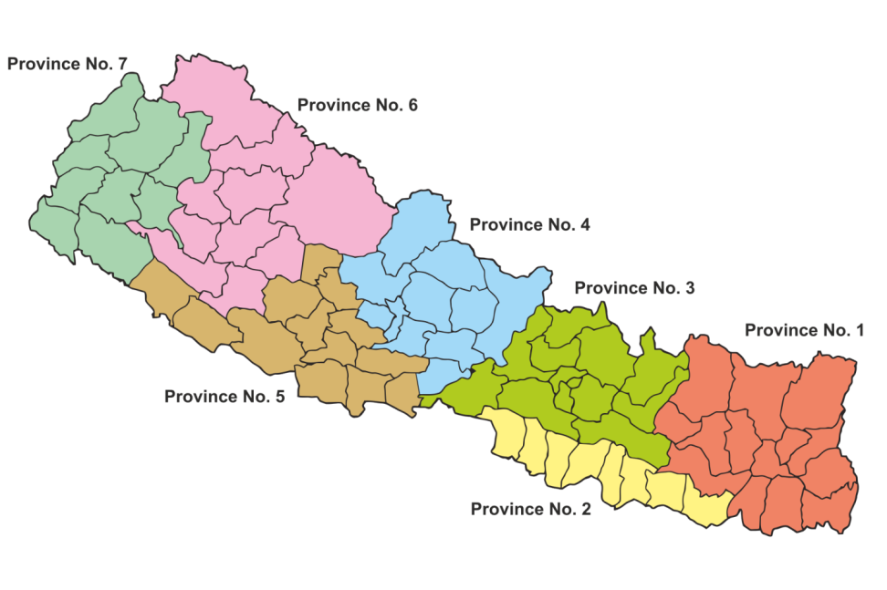
The country is divided into 7 provinces and 77 districts.
2
1
3

Slide 5
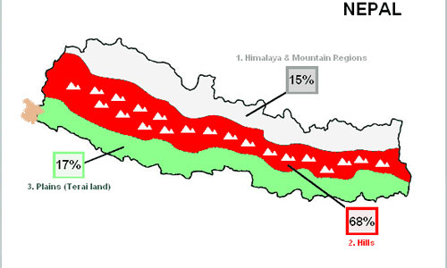

Slide 6
Number of sample children by district and school
Districts | No. of Schools | No. of Students
Chitwan | 26 | 26 x 36 children = 936
Dhading | 20 | 20 x 36 children = 720
Dolakha | 12 | 12 x 36 children = 432
Total | 58 | 2088

Slide 7
No. of children by gender and age group
Gender | 10 years | 12 years | Total
Boys | 510 | 529 | 1044
Girls | 534 | 515 | 1044
Total | 1044 (1004) | 1044 (1041) | 2088 (2045)

Slide 8
Children’s Views on and Perception of Safety

Slide 9
Reasons from ISCWeB
I live with my family at home or rented room.
10 years : 94.9%
12 years: 96.8%
Family members care about me
By gender
Boys: 3.53
Girls: 3.59
By age
10 years : 3.46
12 years: 3.66

Slide 10
Reasons from Children’s Understanding of Well-Being (CUWB) for being safe at home
Elders’ care and love
Instructions on dos and don’ts for safety
Native girls are safer than the girls living in rented rooms.

Slide 11
Reasons from ISCWeB
My teachers care about me
By gender
Boys: 3.34
Girls: 3.37
By age
3.28
3.43

Slide 12
Reasons from CUWB for being safe at school
Children feel safe at school because of good physical facilities and teachers’ care
CCTV surveillance ensured safety of children
Maintained safety of children because of almost no corporal punishment

Slide 13
Reasons from CUWB
Children living nearby school feel safe on the way to and from school
Students who need not cross highway feel safe
Girls who use public buses encounter harassment
In rural areas, not safe for some students who need to walk through forest and slippery road during rainy season

Slide 14
Reasons from ISCWeB
Enough places to play or to have a good time
By gender
Boys: 2.66; Girls: 2.88
By age
10 years old: 3.03
12 years old: 2.51
People in my local area help me in my problem
By gender
Boys: 3.22; Girls: 3.24
By age
10 years old: 3.15
12 years old: 3.31

Slide 15
Reasons from ISCWeB (Conti.)
Minimal quarrels and fights in local area
Reasons from CUWB
Peace in the local area: minimal fights/quarrels and no noises.

Slide 16
Perception of Children about Nepal (%)
Statement | I do not agree | I agree a little | I agree somewhat | I agree a lot | I totally agree
Nepal is a safe place for children to live | 3.2 | 7.8 | 10.5 | 22.8 | 55.7

Slide 17
Conclusions
Children are safe at home
Children are safe at school
Children are safe at their local area, but it is less satisfactory compared to safety at home and at school
Safety of children on the way to and from school is less satisfactory compared to safety at home and school.

Slide 18
Thanks

Slide 19
Scale | value
I do not agree | 0
Agree a little bit | 1
Agree somewhat | 2
Agree a lot | 3
Totally agree | 4
Don’t know | 90
Not asked | 92
Missing | 99

Slide 20
Scale | value
Not at all safe | 0
Not very safe | 1
Quite safe | 2
Very safe | 3

