Slide 1



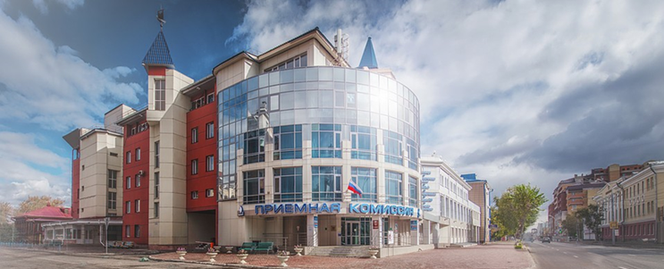
Children`s World Nantes Meeting
20th – 21th of May, 2019
Reflective component in the structure
of children's subjective well-being or
What do Russian children need to be happy
Zhanna Bruk, Russia, University of Tyumen, Institute of Psychology and Education Department of Childhood`s Psychology and Pedagogy, bruk_882@mail.ru
Svetlana Ignatjeva, University of Tyumen, Russia
Daugavpils University, Latvia

Slide 2
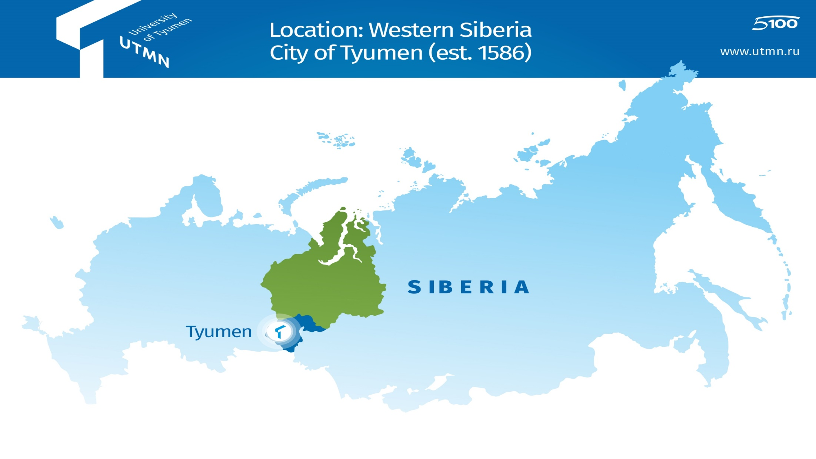
University of Tyumen
1,300 professors and researchers
19,800 bachelor and master students
350 PhD students
3 campuses (Tyumen, Tobolsk, Ishim)
University of Tyumen
1930 founded
40 in national rating
5/100 Federal Academic Excellence
Program

Slide 3
Main point of the presentation
Background of the survey in Tyumen region of Russia
Sampling strategy
Russian team
Methodology
Results of the study
Practical recommendations

Slide 4
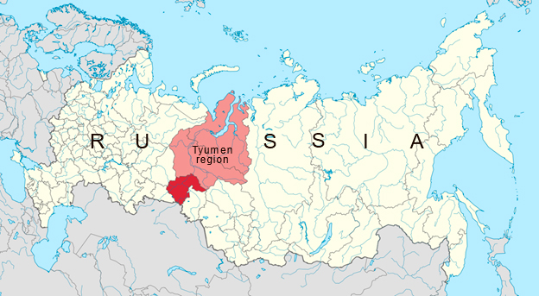
The population of Russia -146 880 432 people
In Russia
from 2018 till 2027
there is a project
«Decade of childhood»
17 100 000 square km
the population of Tyumen region – 3 723 984 people.
1 435 000 square km
Background of the survey in Tyumen region of Russia

Slide 5

Background of the survey
in Tyumen region of Russia

Slide 6
Sampling
The survey was conducted only in educational institutions of Tyumen region.
The total sample amount is 1959 students:
10 years old - 977 children
12 years old - 982 children
The survey of different age groups covers as a rule the same schools.

Slide 7
Sampling
stratum 1 – geographical regions. The sample is continuous, all subjects of the Tyumen region were included.
The Tyumen region includes three subjects:
Khanty- Mansiysk Autonomous Area – Ugra (43% of 10 years old children, 45% of 12 years old children) - North of the Tyumen region,
Yamalo-Nenets Autonomous District (14% of 10 years old children, 14% of 12 years old children) - North of the Tyumen region;
South of Tyumen region (23% of 10 years old children, 21% of 12 years old children),
and Tyumen – the capital of the region (18% of 10 years old children, 18% of 12 years old children).

Slide 8
Sampling
stratum 2 - types of areas – urban and rural areas - calculated the proportion of the population.
Within the region:
urban area - the largest cities of each territory were chosen, in rural areas – randomly.
The urban population of the region is about 80%, rural population - about 20%.
About 18% of the sample were children from rural areas, 82% - of the sample were children from urban area.
stratum 3 - gender
stratum 4 - age

Slide 9
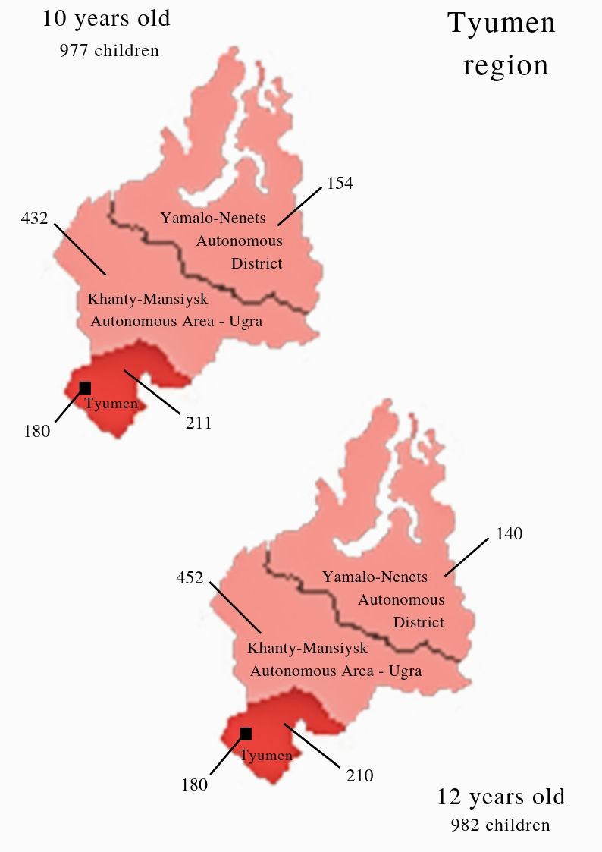
Total number of children in the Tyumen region:
10 years old - 51079 children
12 years old - 44561 children
Children from 24 schools
(from 613 schools in the region )
of 9 cities and
5 rural settlements
took part in the survey.
10 years old
522 (53/4%) – girls
455 (46.6%) - boys
12 years old
485 (49.4%) – girls
497 (50.6%) - boys
Sampling

Slide 10
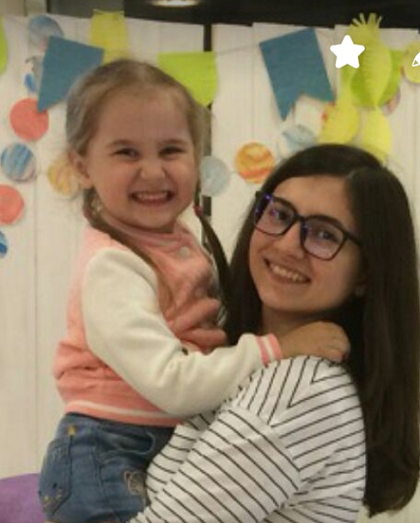
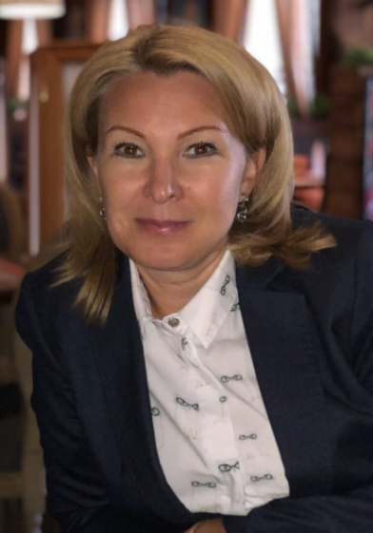
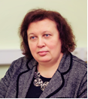

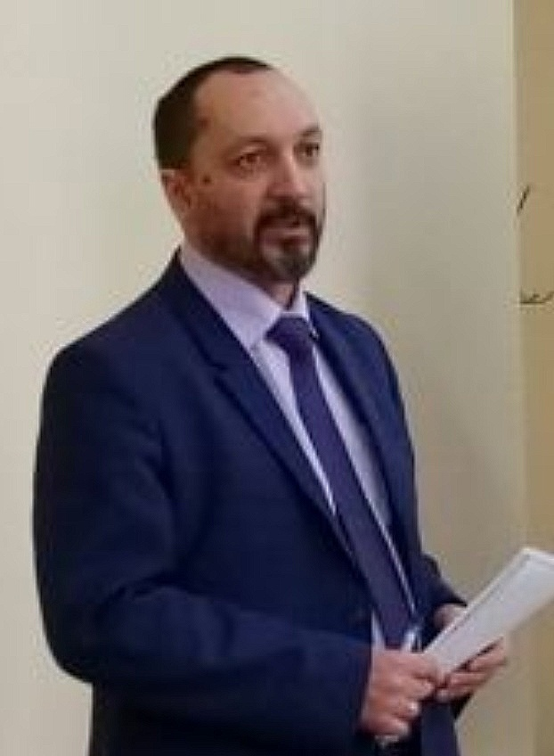
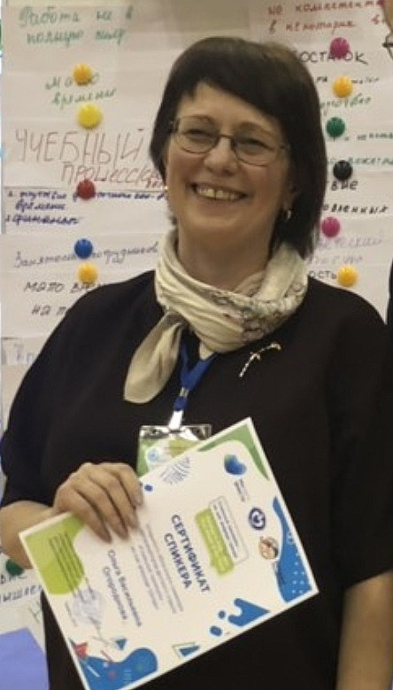
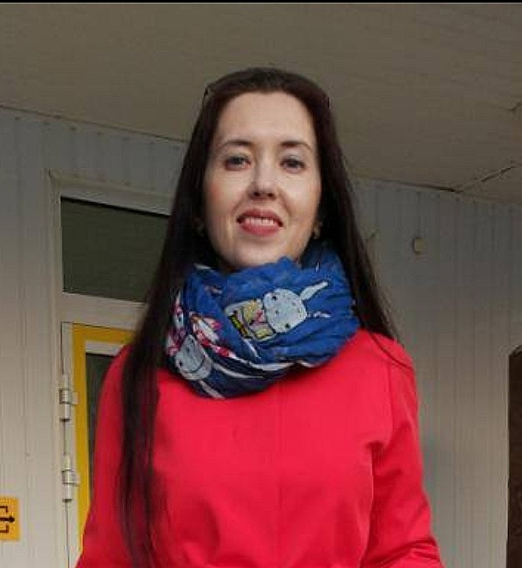
Russian team
Department of Childhood`s Psychology and Pedagogy
Svetlana Ignatjeva
Professor of the Department
Zhanna Bruk
assistant professor
Marina Mitrikovskaya
Department assistant
Anastasiya Frolenkova
assistant of the Department
Tatiana Semenovskikh
assistant professor
Evgeniy Kukuev
assistant professor
Olga Ogorodnova
Head of the Department

Slide 11
Methodology
There are following indicators of the phenomenon studied:
1. Children’s Worlds Subjective Well-Being Scale – 6 items measuring cognitive subjective well-being (Based on the Student Life Satisfaction Scale by Huebner, 1991) (Q25)
2. Children’s Worlds Domain Based Subjective Well-Being Scale – 5 items measuring domain based cognitive subjective well-being (based on the Brief Multidimensional Student Life Satisfaction Scale by Seligson, Huebner & Valois, 2003) (Qs 11,25,28,36,41)
3. Indicators:
Satisfaction with: All the things you have,
Satisfaction with: The house or flat where you live.

Slide 12
Methodology
Subjective
well-being
Intrareflexive component
I am happy with my life
The things that happen in my life are excellent
Interreflexive component
Satisfaction with: All the things you have
I like my life
I have a good life
My life is going well
Satisfaction with: The area where you live
Satisfaction with: What may happen to you later in your life
Satisfaction with: The people you live with
Satisfaction with: The house or flat where you live
Satisfaction with: Your friends
Satisfaction with: Your life as a student
Satisfaction with: The way that you look
Factors (components) of subjective well-being

Slide 13
 | Component
 | 1 | 2
I have a good life | ,874
I like my life | ,867
I am happy with my life | ,865
The things that happen in my life are excellent | ,853
My life is going well | ,840
I enjoy my life | ,817
Satisfaction with: Your life as a whole | ,745
Satisfaction with: The freedom you have | ,611
Satisfaction with: The people you live with | ,534 | ,448
Satisfaction with: What may happen to you later in your life | ,488
Satisfaction with: Things you have learned |  | ,755
Satisfaction with: Your life as a student |  | ,718
Satisfaction with: The house or flat where you live |  | ,663
Satisfaction with: The area where you live |  | ,642
Satisfaction with: Your friends |  | ,573
There is perform an exploratory factor analysis, to reduce the dimensionality of space indicator for phenomenon under consideration.
ClusterGroup1
 |  | Frequency | Percent | Valid Percent | Cumulative Percent
Valid | 1 | 237 | 12,1 | 12,1 | 12,1
 | 2 | 1249 | 63,8 | 63,8 | 75,9
 | 3 | 473 | 24,1 | 24,1 | 100,0
 | Total | 1959 | 100,0 | 100,0

Slide 14
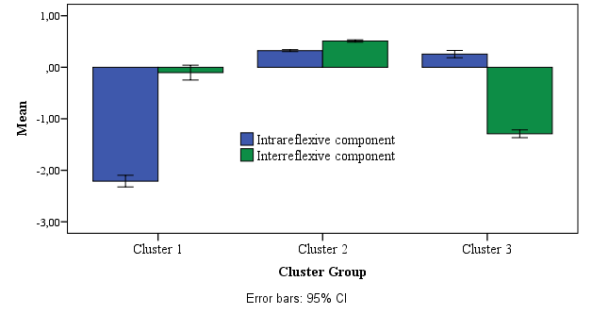
Results of the study
Cluster group 3
24.1% -
«conditionally advantaged children» - these children are happy with things
that they have
Cluster group 1 12.1% - «disadvantaged
children”
Cluster group 2 - «advantaged children» - 63.8% - children with a level of satisfaction of life above average
A qualitative interpretation of the obtained statistical data gave a possibility to divide children into groups:

Slide 15
Results of the study
We assume that the cognitive component of subjective well-being arises with a coherent, relatively consistent picture of the world for person,
when he understands the current life situation:
if the Intrareflexive component and the Interreflexive component are in balance, the child is well–«advantaged»;
if the child «falls» Interreflexive component, then it is «conditionally advantaged»;
if the child «falls» Intrareflexive component, the child is unsuccessful – «disadvantaged».

Slide 16
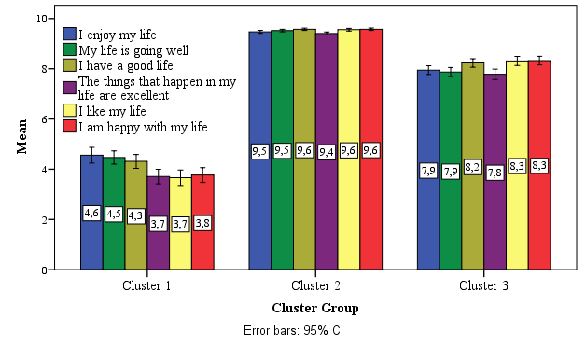
Results of the study
Cluster group 1 -12.1% - «disadvantaged
children”
Cluster group 2- «advantaged children» - 63.8%
children with a level of satisfaction of life above average
Cluster group 3 - 24.1% - «conditionally advantaged children» - these children are happy with things that they have

Slide 17
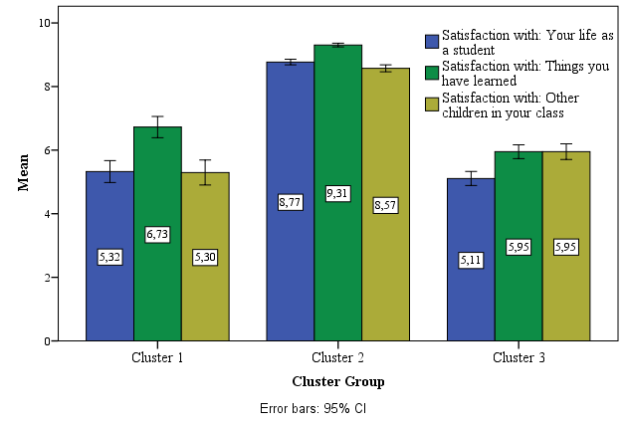
Results of the study
Cluster group 1 -12.1% - «disadvantaged
children”
Cluster group 2- «advantaged children» - 63.8%
children with a level of satisfaction of life above average
Cluster group 3 - 24.1% - «conditionally advantaged children» - these children are happy with things that they have

Slide 18
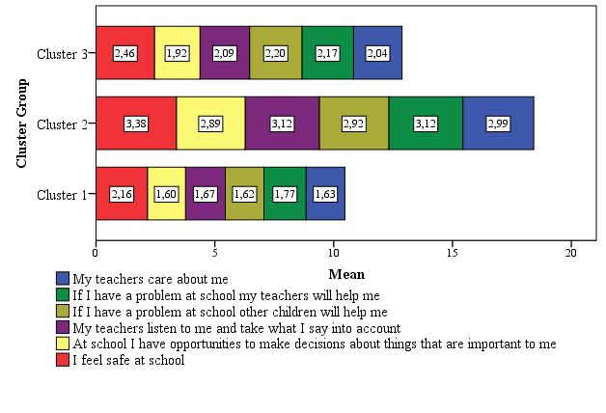
Results of the study

Slide 19
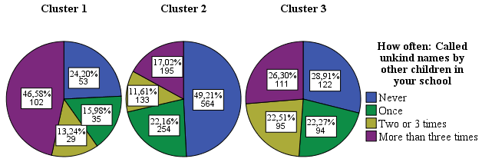
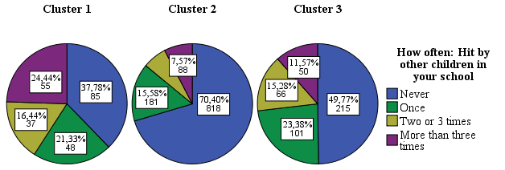
Results of the study

Slide 20
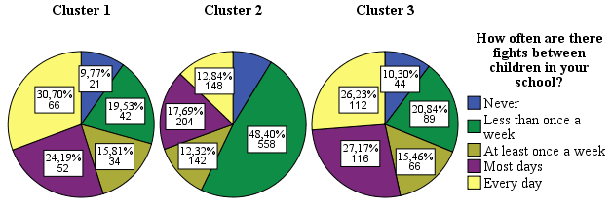
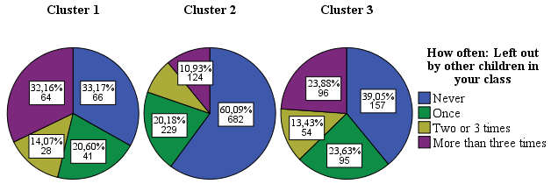
Results of the study

Slide 21
Results of the study

Slide 22
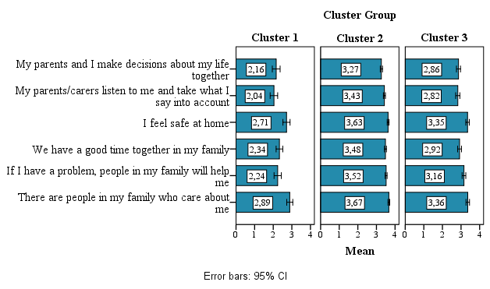
Results of the study

Slide 23
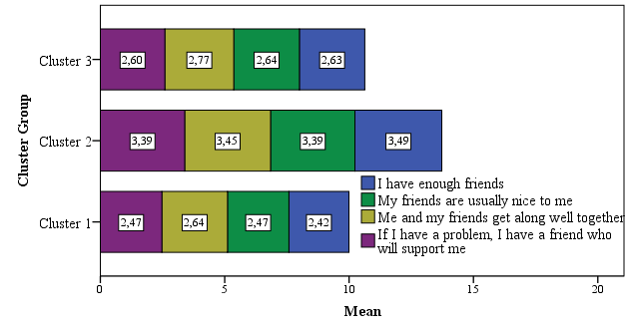
Results of the study

Slide 24

Practical recommendations
conducting happiness trainings and work-shops;
differentiation and individualization in the process of psychological and pedagogical support of the child;
study of factors affecting the subjective well-being of children;
optimization of subjective well-being through the development of factors determining the child’s subjective well-being;
targeted interaction with parents; educational work with parents.

Slide 25
Thank you for your attention!
Reflective component in the structure
of children's subjective well-being or
What do Russian children need to be happy
Zhanna Bruk, Russia, University of Tyumen, Institute of Psychology and Education Department of Childhood`s Psychology and Pedagogy, bruk_882@mail.ru
Svetlana Ignatjeva, University of Tyumen, Russia
Daugavpils University, Latvia

