Slide 1





Children’s Worlds International Survey of Children’s Well-Being
Conducting Cross-Country Comparative Research
Shazly Savahl¹ & Sabirah Adams²
Donnay Manuel¹, Mulalo Mpilo¹
¹Child & Family Studies, University of the Western Cape
²Centre for Higher Education Development, University of Cape Town

Slide 2

Outline of presentation
Key Issues in Cross-cultural Research
Cross-Country Comparisons (Safety and Bullying)

Slide 3
The structure of subjective well-being
Subjective well-being is generally defined as a broad concept that includes the cognitive and affective evaluations that individuals make concerning their lives, the events influencing their lives and the circumstances in which they live
The cognitive element refers to perceptions of global and domain specific life satisfaction, while the affective element refers to the experience of positive and negative affect.
These components are conceptualised as fitting on a hierarchical structure; being moderately correlated, conceptually related, with each making a unique contribution towards subjective well-being.
When we ask children about their subjective well-being, we are essentially asking them to appraise the extent to which they are satisfied with their life in general, with various aspects of their life, and how they feel about their life.

Slide 4
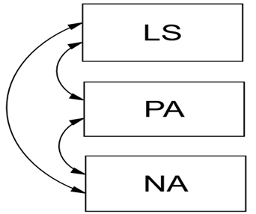
Model 1: SWB as 3 Separate Components
Busseri and Sadava (2011)
SWB

Slide 5

Model 2: SWB as Hierarchical Construct
LS
PA
SWB
NA

Slide 6
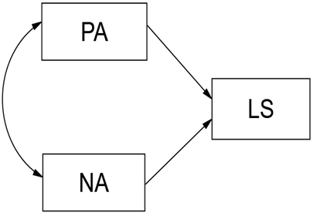

Model 3: SWB as a Causal System
SWB

Slide 7
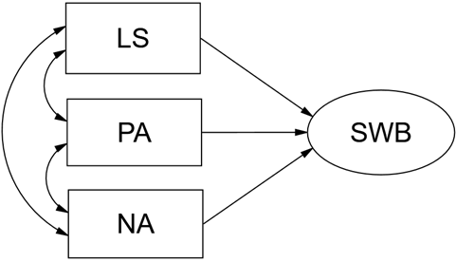
Model 4: SWB as a Composite

Slide 8
Model 5: SWB as a Configuration of Components
High SWB
Low SWB
high LS
low LS
high PA
moderate PA
low NA
moderate NA

Slide 9
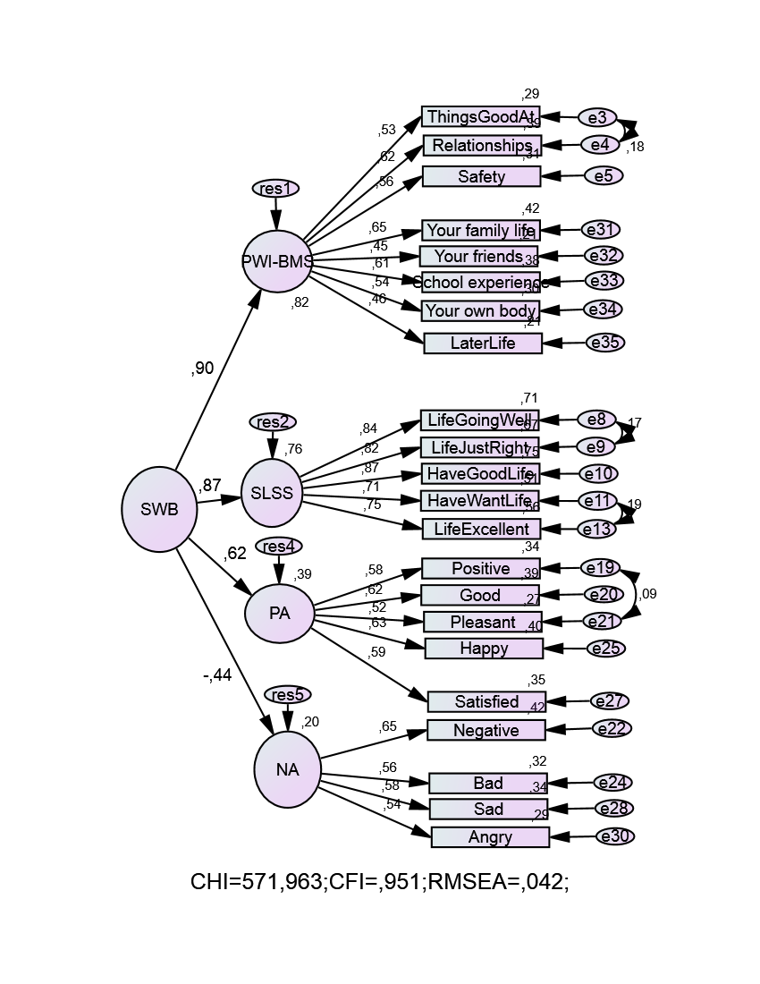
SWB as a Quadripartite Hierarchical Structure

Slide 10
Children’s Worlds: International Survey of Children’s Well-Being
What measures do we have
Over the past few years researchers have developed (adapted) a range of scales (measures) which have demonstrated sound psychometric properties; most notably structural validity:
SLSS (context-free)
BMSLSS (concretely worded)
PWI-SC (abstractly worded)
CWSWBS
SPANE
PANAS-C
Children’s Worlds Survey has made substantial advancements with these instruments, especially as it relates to cross-culturally measuring SWB in children
The key questions are:
  is SWB perceived and experienced universally by all children?
  and if so, how do we best measure SWB?
  and if so, can we meaningfully compare results across different countries?

Slide 11
First Wave: (Deep Pilot): Is SWB in children universal? Can we measure SWB in children in different contexts? How do we measure SWB?
Second Wave: Can we meaningfully compare SWB across cultures/countries?
Third Wave: How can we improve the measurement of SWB in children?

Slide 12
Second Wave:
Can we meaningfully compare SWB across cultures/countries?
Casas 2016 has shown varying degrees of measurement equivalence of SWB measures used in Second Wave
Countries are somewhat (partially) comparable on instruments across countries. The items have the same meaning across countries.
Countries can be meaningfully compared by correlations, regression coefficients and mean scores.

Slide 13
Third Wave:
How can we improve the measurement of SWB in children?

Slide 14
Comparative and cross-cultural research
Comparative research: it is key to consider cultural diversity within and across nations (e.g. racial-ethnic, religious, language etc.) (Byrne et al., 2009)
Given the substantial increase in cross-cultural research, three trends that have emerged:
  More researchers conducting cross-cultural research with little formal training
  Adaptation of instruments for use within a particular context(s)
  Expertise in advance research design and statistical analyses
These three conditions plays an important role in preparation and practices of researchers
Cultural differences, such as language, societal structures, values, and socialization practices, can contribute to differences in the meaning or structure of a measured construct and the perception of its related item content
Notes:
May require more than one slide

Slide 15
Overarching methodological concerns in cross-country research
  assumption of equivalent psychological meaning and factorial structure of a measuring instrument across cultural groups
    Functional equivalence (does the construct exist in all groups studied)
    Structural equivalence/ construct (extent to which the meaning and dimensional structure of a psychological construct are identical across cultural groups)
    Measurement equivalence (extent to which both the item content and psychometric properties of the instrument are similar across groups, e.g. item translation is a special case of measurement equivalence and linguistic equivalence)
      Configural (is the basic structure same structure across groups)
      Metric (are loading weights identical across groups – allows for comparison by correlations, regressions)
      Scalar (are intercepts, origin of measurement scale, identical across groups – allows for mean comparisons)
  failure to take into account the hierarchical nature of the cultural data, and
    Cross-cultural data are hierarchically (multi-level) structured: Individuals are nested within culture
    Consider individual and country level
  lack of familiarity with ethical issues governing scale adaptation and use in diverse cultural settings
    Country Ethics Codes for research; International Test Commission
The importance of training emerging researchers with expertise in the above
It is crucial to consider the above in conducting comparative analysis using the Children’s Worlds data
    (Byrne et al., 2019)
Notes:
May require more than one slide

Slide 16
Overarching methodological concerns in cross-country research
Key Questions:
  How can identify and prevent non-equivalence?
  What strategies can be used for overcoming measurement bias?
Take note of instrument construction adaptation/translation*/data collection procedures (measurement bias)
Take note of in-country variation (especially in multicultural societies). Are in-country samples of children a homogenous group?
  For example in SA even ‘Black African’ culture are not homogenous
  Substantial cultural variation in ‘Black African culture’**
Caution against cross-country comparisons without establishing intra-country measurement invariance
Notes:
*Ensuring standardised procedure of translation. Consider different dialects of the same language. Similar sampling strategies. Well-trained researchers for data collection
** An example from South Africa to follow

Slide 17
Children’s Worlds
Wave 3
South Africa
11 official languages
Wave 3 (8 languages – including English)
  Followed procedure as outlined by the International Test Commission “The ITC Guidelines for Translating and Adapting Tests” (2017, 2nd edition)
  A double-translation and reconciliation procedure using a 3rd translator and expert committee
  Cognitive testing with children
Administration of questionnaire was uniform
  One group of researchers responsible for data collection, accompanied by one of the project PI’s
  Researchers received training (especially on scale response options and items that were potentially difficult to understand)
  Building rapport (‘buy in’) with children was crucial in contributing to the answering of the questionnaire. Children were more enthusiastic and excited.
Notes:
*Concern was noted as the children lacked capacity to answer the questionnaire in their home language

Slide 18
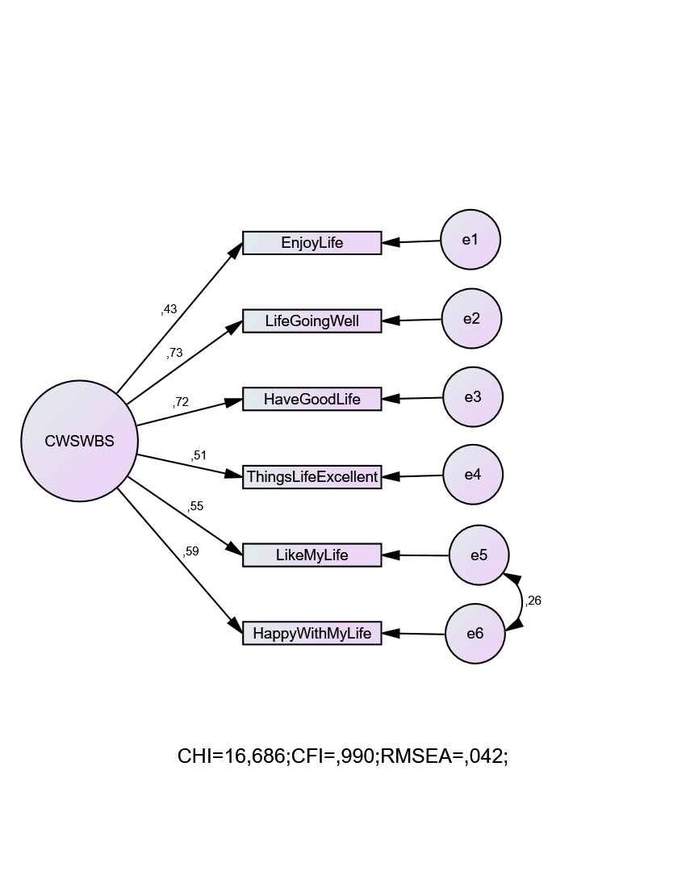
Overall Model of the CWSWBS
Three Language Groups
Tshivenda, Setswana, Xitsonga

Slide 19
Language Group Comparisons
 | Full | Partial
Configural | √
Metric | X | √ (with one item freely estimated)*
Scalar | X | √ (with two items freely estimated)**
*I enjoy my life
** I enjoy my life AND I am happy with my life
Meaningful comparisons across the three language groups (by correlation and regression coefficients, and mean scores, are only possible with these four items)
My life is going well
I have a good life
The things in my life are excellent
I like my life

Slide 20
Wave3:
Preliminary Cross-Country Descriptive Analysis
(Safety and Bullying Items)

Slide 21
Method: Children’s Worlds Wave 3
10 Year Old Dataset
The data:
  10-year olds
  22 countries
  Unweighted preliminary data
  Total sample: N = 35 157
There were six items that had less than 10% missing data,
  the item on overall safety (Satisfaction with how safe you feel) had the lowest level of missing data (1.6%).
  The questions on sibling bullying victimisation are not included in the current analysis

Slide 22
Wave 3: 10-year old sample across 22 countries
Country | N | Boy | % | Girl | %
Albania | 1176 | 605 | 51.7 | 566 | 48.3
Algeria | 1137 | 546 | 48.1 | 588 | 51.9
Bangladesh | 946 | 419 | 45.2 | 509 | 54,8
Belgium | 1112 | 548 | 50.5 | 537 | 49.5
5. Sri Lanka | 1154 | 607 | 53.8 | 521 | 46.2
Taiwan | 1356 | 676 | 49.9 | 680 | 50.1
Estonia | 1013 | 470 | 46.6 | 539 | 53.4
France | 2184 | 1064 | 49.2 | 1098 | 50.8
Germany | 829 | 354 | 47.4 | 393 | 52.6
Greece | 822 | 401 | 49.2 | 414 | 50.8
India | 946 | 465 | 49.2 | 481 | 50.8
Indonesia | 7680 | 3748 | 49.2 | 3871 | 50.8
Israel | 1637 | 819 | 50.2 | 814 | 49.8
14. S Korea | 3203 | 1549 | 48.4 | 1654 | 51.6
Malaysia | 994 | 445 | 44.8 | 549 | 55.2
Malta | 648 | 371 | 57.6 | 273 | 42.4
Nepal | 1004 | 475 | 47.7 | 521 | 52.3
Norway | 801 | 423 | 52.8 | 378 | 47.2
Poland | 1195 | 591 | 49.7 | 599 | 50.3
Vietnam | 946 | 496 | 52.8 | 444 | 47.2
21. S Africa | 3415 | 1612 | 47.2 | 1803 | 52.8
22. Wales | 959 | 478 | 49.9 | 480 | 50.1
TOTAL | 35157 | 17162 | 100 | 17712 | 100

Slide 23
SAFETY AND BULLYING ITEMS
QUESTION | RESPONSE OPTION
Safety
I feel safe at home | Five-point agreement scale (0 – I do not agree) to (4 – Totally agree)
I feel safe at school | Five-point agreement scale (0 – I do not agree) to (4 – Totally agree)
I feel safe when I walk in the area I live in | Five-point agreement scale (0 – I do not agree) to (4 – Totally agree)
How safe do you feel on your way to and from school | Four-point rating scale (0 – Not at all safe) to (3 – Very safe)
How often are there fights between children in your school? (each week) | Four-point frequency scale (0 – Never) to (3 – More than three times)
Country is a safe place to live | Five-point agreement scale (0 – I do not agree) to (4 – Totally agree)
How satisfied are you with your safety? | End-labelled agreement scale (0 – Not at all satisfied) to (10 – Totally satisfied)
School Bullying victimisation
Hit by other children in your school (in the last month)? | Four-point frequency scale (0 – Never) to (3 – More than three times)
Called unkind names by other children in your school (in the last month)? | Four-point frequency scale (0 – Never) to (3 – More than three times)
Left out by other children in your school ((in the last month)? | Four-point frequency scale (0 – Never) to (3 – More than three times)
Notes:
Items on sibling bullying victimization are not include in this analysis

Slide 24
Reliability analysis across safety and bullying items
SAFETY ACROSS THREE SETTINGS |  | SCHOOL BULLYING VICTIMIZATION
Country | Cronbach's Alpha | Country | Cronbach's Alpha
Albania | .365 | Albania | .639
Algeria | .355 | Algeria | .535
Belgium | .479 | Bangladesh | .579
Sri Lanka | .445 | Belgium | .738
Taiwan | .611 | Sri Lanka | .671
Estonia | .517 | Taiwan | .619
France | .496 | Estonia | .753
Greece | .572 | France | .624
Indonesia | .449 | Germany | .716
S Korea | .493 | Greece | .659
Malta | .547 | India | .595
Nepal | .591 | Indonesia | .691
Norway | .387 | Israel | .697
Vietnam | .636 | S Korea | .207
S Africa | .578 | Malaysia | .572
Wales | .463 | Malta | .711
- | - | Nepal | .658
- | - | Norway | .663
- | - | Poland | .728
- | - | Vietnam | .560
- | - | S Africa | .605
- | - | Wales | .699
Pooled Sample | .512 | Pooled Sample | .707

Slide 25
Results:
Safety

Slide 35
Results:
Bullying victimisation

Slide 36
BULLYING VICTIMISATION: SCHOOL

Slide 37
BULLYING VICTIMISATION: SCHOOL

Slide 38
BULLYING VICTIMISATION: SCHOOL

Slide 39
BULLYING VICTIMISATION: SCHOOL

Slide 40
Results:
Safety and Bullying victimisation across developed and developing countries

Slide 41
Country Categorization
*Developed | F | % | *Developing | F | %
Belgium | 1112 | 7.1 | Albania | 1176 | 6.1
2. Taiwan | 1356 | 8.6 | 14. Algeria | 1137 | 5.9
3. Estonia | 1013 | 6.4 | 15. Bangladesh | 946 | 4.9
4. France | 2184 | 13.9 | 16. Sri Lanka | 1154 | 5.9
5. Germany | 829 | 5.3 | 17. India | 946 | 4.9
6. Greece | 822 | 5.2 | 18. Indonesia | 7680 | 39.6
7. Israel | 1637 | 10.4 | 19. Malaysia | 994 | 5.1
8. S Korea | 3203 | 20.3 | 20. Nepal | 1004 | 5.2
9. Malta | 648 | 4.1 | 21. Vietnam | 946 | 4.9
10. Norway | 801 | 5.1 | 22. S Africa | 3415 | 17.6
11. Poland | 1195 | 7.6
12. Wales | 959 | 6.1
TOTAL | 15759 | 100 | TOTAL | 19398 | 100
* Based on World Bank 2019

Slide 42
I feel safe at school

Slide 46
Discussion and Conclusion
Across three settings (home, school, and area (neighbourhood) most children feel safer at home, and least safe walking within the area in which they live.
Considering specific countries, there are variations in terms of safety in these contexts
  Children in developing countries felt least safe across the 3 settings.
  Malaysia, South Africa, Vietnam, Nepal (with Germany being the exception) had the highest percentage of children who felt unsafe consistently across the three settings.
  Safety within the home and area (neighbourhood), children in South Africa felt least safe, exceeding other countries.
  Other developing countries such as Sri Lanka, Algeria, and India had similarly high levels of children who felt unsafe in their area.
  While Poland and Estonia had the highest proportion of children who felt safe at home, interestingly children in Germany, along with Vietnam and Nepal, felt least safe at home.
  South Korea had the highest proportion of children who felt safe in their area, and among the highest for those who felt ‘somewhat’ and ‘a little’ safe at school.
Notes:
May require more than one slide

Slide 47
Discussion and Conclusion
For overall safety, two thirds of the sample were completely satisfied with their overall safety.
  A consideration by country showed great variation
  This question should be used and interpreted with caution across countries
  It shows a high correlation with overall life satisfaction, and a weaker association with safety in the three settings (for Wave 2).
  In-country comparisons should also be conducted with caution, given variations and the need to validate the use of scale across age and language groups.

Slide 48
Considerations for research teams
This preliminary analysis has indicated that the items on safety and bullying victimisation work well across the 22 countries for the 10-year olds.
It is evident that the three items on bullying victimisation work well as a scale across most countries, except South Korea (α = .207) and should perhaps not be used as a scale in this context.
It was also found that the 3 items on safety across three contexts (home, school, neighbourhood) did not work well as a scale in any of the countries. It is therefore recommended that these items should not be used as a scale for the overall sample or per country
It is important to conduct analyses on in-group variations within countries to determine whether the items work well across groups. For example, in the South African context for Wave 3, it was found that certain scales that assess children’s SWB do not work well across language groups located in different provincial locations, and are therefore not comparable.
A consideration of cross-country comparisons across groups in terms of developed and developing contexts are also useful in providing an indication of children’s SWB across various domains.
Finally, it is recommended that the item on children’s overall safety be used with caution across and within country analyses.

Slide 49
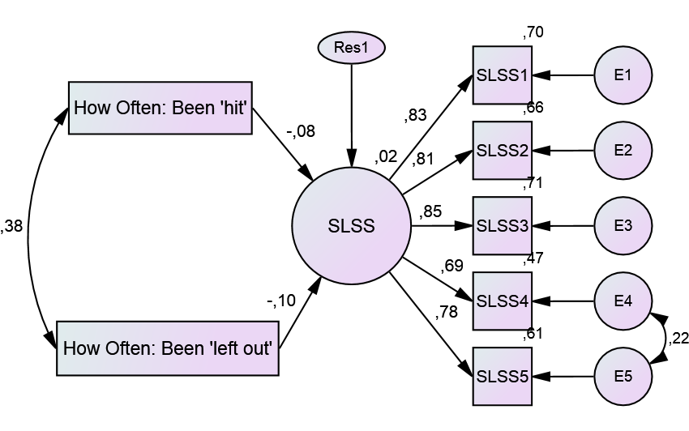
Wave 2
Relation between bullying victimization and SWB

