Slide 1
Statistical orientation

Slide 2
Data cleaning
Checks on all coding and labelling
Adding some variables in preparation for international data set
Checking variables with high levels of missing (>10%)
Identifying cases for exclusion
  More than two years outside target age
  More than 50% missing values
  Consistent responding to questions about frequency of activities
Variables also added to indicate systematic responding:
  Agreement questions
  Satisfaction with different aspects of ife
  Overall SWB questions

Slide 3
Taking account of survey design
Weighting, to take account of:
  Unequal probabilities of selection
  Non-participation
  Differences between sample plan and outcomes
  Combining age groups
Stratification
  e.g. Region, School type
Clustering
  Children are clustered in schools
  Children within schools are more similar than average
  We don’t have a simple random sample of children

Slide 4
Gender differences in life satisfaction
South Africa, Wave 2
Unweighted
Weighted
Survey design (with weighting)

Slide 5
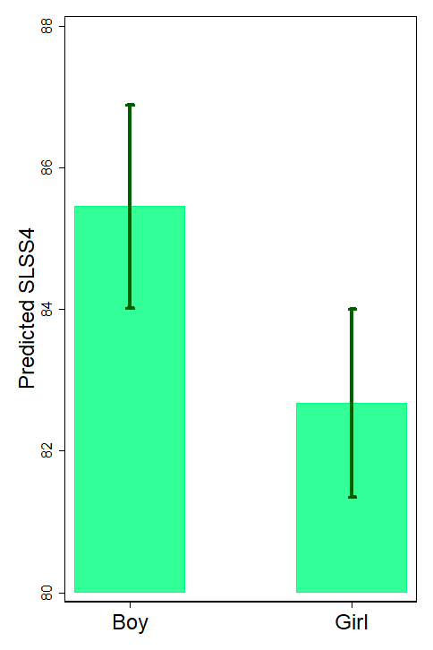
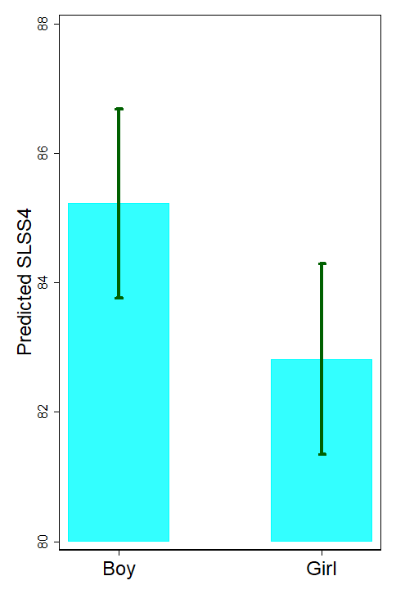
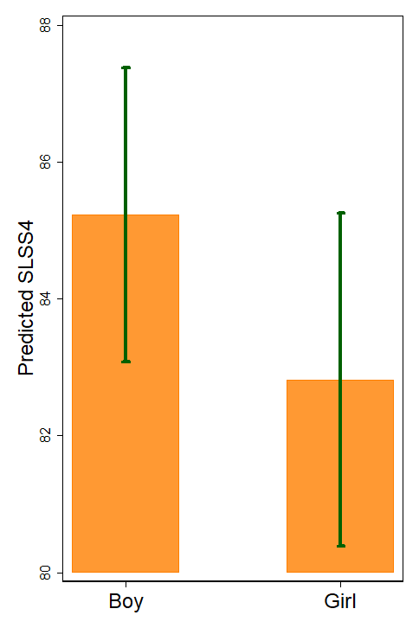
Unweighted
Weighted
Survey design
2.8
2.4
2.4

Slide 6
Complex survey analysis: Options
SPSS
Define a CSPLAN
Then use various options such as CSDESCRIPTIVE, CSTABULATE, CSLOGISTIC
Or can be done through menu commands, but time-consuming
Stata
Define svyset
Use ‘svy:’ prefix for commands
R (completely free!)
Use the ‘survey’ package, which includes defining a complex design and various commands such as svymean, svytotal, svyglm

Slide 7
Differences in 8-years-old survey
Wave 2, two questions
How happy are you with your life as a whole (5-point smiley faces scale)
Up to now how happy are you with your overall life (11-point 0-10 scale)
 | Score on the five-point scale
 | 0 | 1 | 2 | 3 | 4
 | Mean score on the 11-point scale
Algeria* | 7.7 | 8.4 | 8.1 | 8.8 | 9.4
Nepal | 7.4 | 7.9 | 8.1 | 8.2 | 8.9
Estonia | 2.5 | 3.1 | 6.8 | 8.1 | 9.3
Spain* | 6.9 | 5.3 | 7.5 | 8.8 | 9.5
Colombia* | 7.3 | 6.4 | 8.6 | 9.0 | 9.7
Turkey | 6.6 | 9.3 | 8.1 | 9.0 | 9.5
Ethiopia | 7.2 | 6.1 | 6.9 | 7.7 | 8.9
S Korea | 4.6 | 4.7 | 6.4 | 7.7 | 9.1
Germany | 2.8 | 3.6 | 5.5 | 7.7 | 9.3
UK* | 3.2 | 6.2 | 6.7 | 8.1 | 9.3
Israel | 5.7 | 5.1 | 7.5 | 8.3 | 9.5
Romania | 5.6 | 9.2 | 8.7 | 9.1 | 9.7
Norway | 4.4 | 5.3 | 6.1 | 8.2 | 9.4
S Africa* | 7.5 | 8.9 | 8.1 | 9.1 | 9.4
Malta | 7.9 | 6.5 | 7.0 | 8.6 | 9.5
Finland | 4.7 | 5.8 | 7.1 | 8.3 | 9.6
Italy | 5.0 | 7.8 | 7.3 | 8.6 | 9.5

Slide 8
Overall well-being - scales

Slide 9
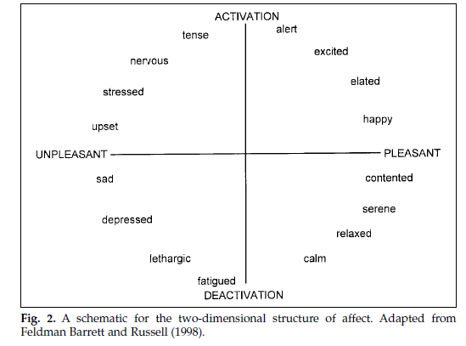
Affect
Stressed
Full of energy
Sad
Happy
Bored
Calm

Slide 10
Psychological well-being
Ryff’s six dimensions
Self-acceptance | I like being the way I am
Environmental mastery | I am good at managing my daily responsibilities
Autonomy | I have enough choice about how I spend my time
Positive relations | People are generally friendly towards me
Purpose in life | I feel positive about my future
Personal growth | I feel that I am learning a lot at the moment

Slide 11
Domains and themes
 | Family | School | Local area | Country
Care | There are people in my family who care about me | My teachers care about me | Adults in my local area are kind to children | Adults in [Country] care about children
Support | If I have a problem, people in my family will help me | If I have a problem at school my teachers will help me | If I have a problem there are people in my local area who will help me
Participation | My parents and I make decisions about my life together | At school I have opportunities to make decisions about things that are important to me | In my local area, I have opportunities to participate in decisions about things that are important to children | In my country children are allowed to participate in decisions that are important to them
Respect | My parent(s) listen to me and take what I say into account | My teachers listen to me and take what I say into account | Adults in my area listen to children and take them seriously | I think in my country adults respect children’s rights
Safety | I feel safe at home | I feel safe at school | I feel safe when I walk around in the area I live in | [Country] is a safe place for children to live

Slide 12
Economic factors
Three dimensions:
Family/household circumstances:
Two alternative sets of items
e.g. Does your family have a car (or other means of transportation)?
Personal deprivation:
List of 8 items
e.g. Do you have clothes in good condition to go to school?
Subjective experience:
3 items
e.g. How often do you worry about family money?

Slide 13
Multi-dimensional poverty
Domain | Measures
Nutrition | Enough food each day
Clothing | Clothes in good condition Two pairs of shoes in good condition
Education | Enough money for school trips and activities The equipment/things you need for school
Information | Access to the internet at home A mobile phone
Services | Running water Toilet that flushes Electricity
Housing | Own room Own bed Place to study

Slide 14
Data time scales
July | Deadline for sending data to be included in first report
September | Data cleaning and weighting will be finished
October-November | Initial analysis for comparative report
December | Full international data set will be circulated
January 2020 | International comparative report published
January 2021 | Data will be publicly available

Slide 15
Publication and dissemination
Everyone is free to publish their own country results in any way they choose, and also international comparative analysis in academic journals at any time
We ask you not to publish simple country comparisons for a wider audience until after the initial report is launched
You can collaborate with others outside the project on the condition that the external person confirms in writing that they will not use the data for any other purpose or distribute it to others.
How can we all work together on journal articles and other publications?

