Slide 1
Taiwanese Children’s School Experiences
Department of Social Work, National Taiwan University,
Prof. Yu-Wen Chen
Brown School of Social Work , Washington University in St. Louis
Ph.D. Student Tzu-Hsin Huang

Slide 2
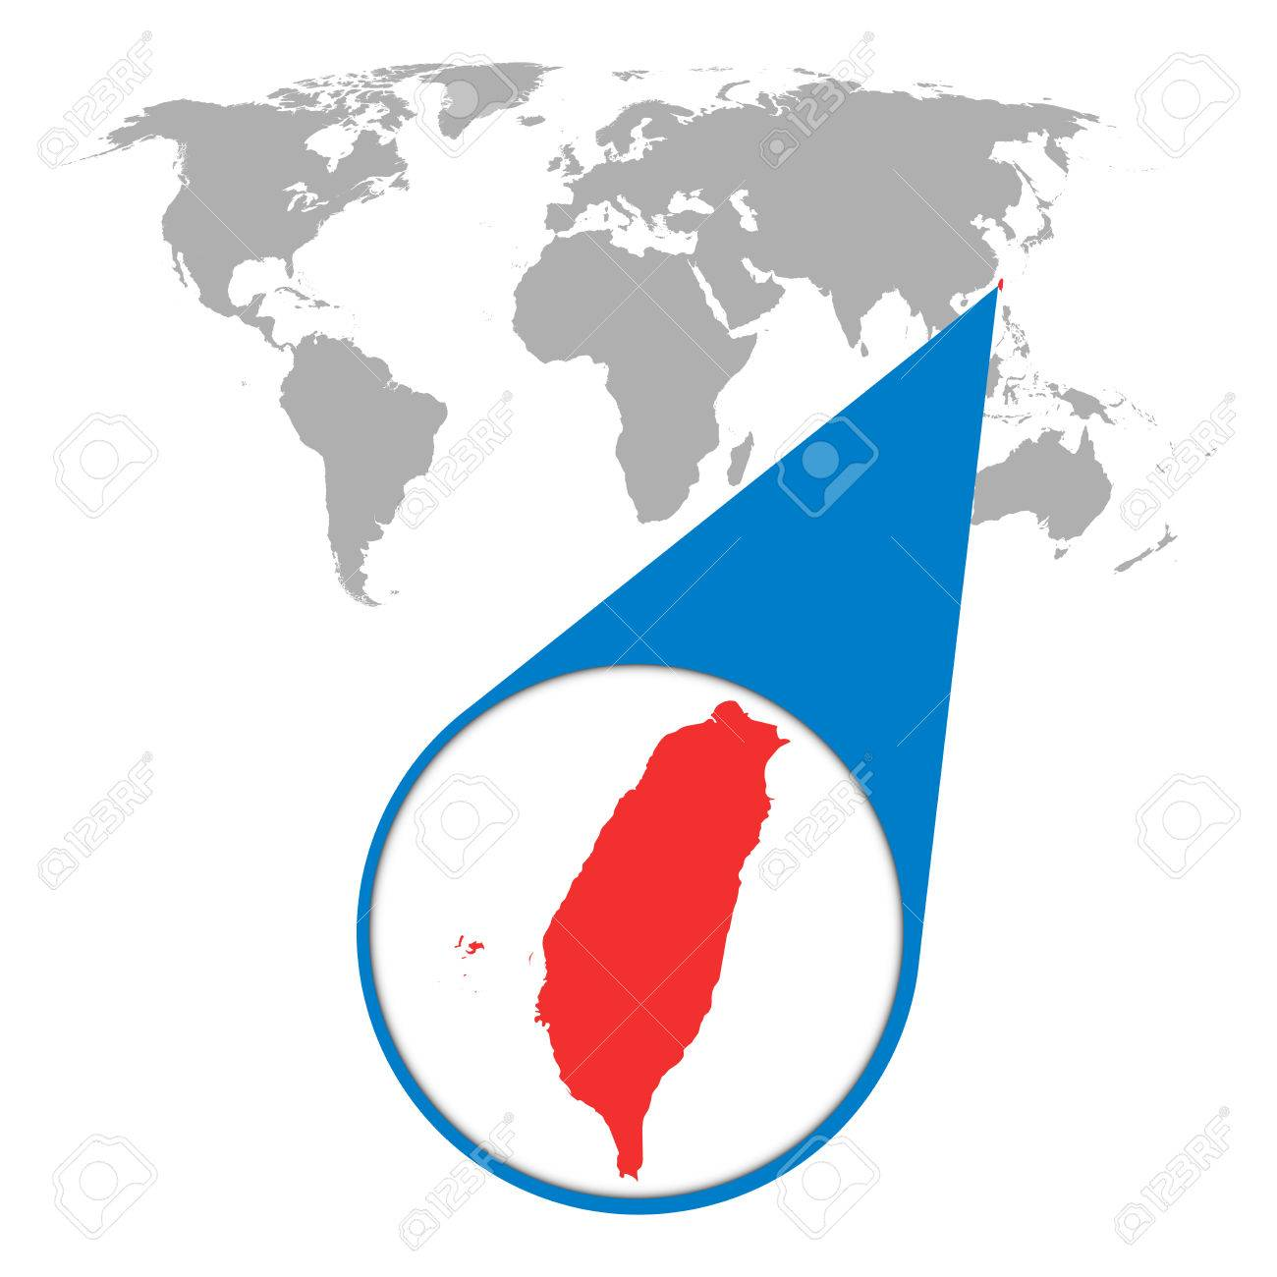
Taiwan in a Nutshell
Total Population (2018): 23,588,932
0-12 yrs old: 2,621,537 (11%)
13-18 yrs old: 1,462,544(6.2%)
Net Enrollment Rate (2016):
  Primary: 99.54%
  Secondary: 95.94%
Expenditure on Primary & Secondary Education (2016): 2.43% (percentage of GDP)
Notes:
Net enrollment rate: girls and boys are quite similar
Expenditure of Education: lower than the average of OECD countries (3.64%) – file i2018 4-1

Slide 3
Sampling Strategies
368 towns/cities are categorized as 6 clusters based on:
  Population density
  Ratio of crop growing and fisheries
  Proportion of aging population
  People with education above the high school level
All are divided into 6 regions based on geographic location
In each selected town/city, one school is randomly selected from a complete school list of that area
When the number of students selected in a school is less than expected, additional one or two schools were selected

Slide 4
Sampling Result
Geo Region | 8 YRS 3rd Grade |  | 10 YRS 5th Grade |  | 12 YRS 7th Grade
Northern | 16 | 4 | 16 | 4 | 16 | 2
Central Northern | 10 | 2 | 10 | 1 | 10
Central | 13 | 2 | 13 | 1 | 12
Central Southern | 10 | 1 | 10 | 1 | 8
Southern | 8 | 3 | 8 | 3 | 8
Eastern | 4 |  | 4 |  | 4
Total Schools | 72 |  | 71 |  | 60
Total Students | 1,341 |  | 1,348 |  | 1,519
Notes:
Rejection rate in cities is higher than in rural areas.
Older students are more likely to take part in the survey, while the parents of younger student are more hesitant to let the kids take survey.

Slide 5
Basics of Sample
 | Female | Indigenous Identity | Disability | New Immigrant Families | Not Born in Taiwan
8 YRS 3rd Grade | 53.5% | N/A | N/A | N/A | N/A
10 YRS 5th Grade | 49.7% | 5.5% | 5.2% | 12% | 2.3%
12 YRS 7th Grade | 50.3% | 6% | 4% | 15.8% | 1.3%
Notes:
Kids were not born in Taiwan were most likely born in China USA, and Vietnam (5th grade)
immigrant moms mostly come from Vietnam, China and Indonesia
immigrant dads mostly come from China (the population is way lower than immigrant mom

Slide 6
Comparison across age GROUPS

Slide 7
Feeling about Friends (%)

Slide 8
Safety of traveling to school (%)

Slide 9
School Satisfaction

Slide 10
School Satisfaction (sum of above items)
 | 8 YRS | 10 YRS | 12 YRS
Mean | 19.61 | 20.15 | 19.13
SD | 4.57 | 4.22 | 4.74
N | 1043 | 1177 | 1343

Slide 11
Frequency about
School bullying

Slide 12
Percentage of Never

Slide 13
Percentage of More than three times

Slide 14
Means Comparison - School Satisfaction
(0-10 scale)

Slide 15
Significant Group Differences
Mean | Opinions about friends (4 items) | Life as a student | Things I have learned at school | Other children in my class
GENDER | t=3.53*** | t=3.01***
girls | 13.36 | 8.00
boys | 12.89 | 7.74
AGE |  | t=5.3*** | t=9.50*** | t=3.56***
10 YRS |  | 8.10 | 8.63 | 8.01
12 YRS |  | 7.66 | 7.90 | 7.70
New immigrant Families | t=2.24* |  | t=2.66**
Taiwanese | 13.21 |  | 8.30
Foreigner | 12.77 |  | 7.98

Slide 16
Conclusion
10-year-old students have the highest satisfaction of life at school
8-year-old students have experienced more bullying at school
Group Differences:
  Girls are more satisfied about friends and life as a students than boys
  10 YRS are more satisfied with life as a student, things they learned and other children in their class
  Kids from New Immigrant Families are less satisfied with friends and things they have learned at school

Slide 17
THANK YOU
Q & A
yuchen@ntu.edu.tw
tzuhsinhuang@wustl.edu

