Slide 1


Children’s Well-being in Vietnam
Truong Thi Khanh Ha
University of Social Sciences and Humanities, Vietnam National University

Slide 2
Introduction
Hanoi capital
Hue
Danang
Haiphong
Nhatrang
HCM city
Vietnam is in South East Asia, facing China, Laos, Cambodia, and Pacific Ocean Vietnam is divided into three regions: North, Midle, and South.
Population in 2017 was 96.160.163 (https://www.indexmundi.com/vietnam/demographics_profile.html)

Slide 3
Population | 96,160,163 (July 2017 est.)
Age structure | 0-14 years: 23.55% (male 11,909,326/female 10,735,324)
Population growth rate | 0.93% (2017 est.)
Urbanization | urban population: 34.9% of total population (2017)
Sex ratio | at birth: 1.11 male(s)/female
Total fertility rate | 1.81 children born/woman (2017 est.)
Religions | Buddhist 7.9%, Catholic 6.6%, Hoa Hao 1.7%, Cao Dai 0.9%, Protestant 0.9%, Muslim 0.1%, none 81.8% (2009 est.)

Slide 4
Family
The average number of children in the household is 1.81
There are more extended families in rural and mountain areas
Vietnamese parents work hard
Children are often reared by their grandparents, or spend long hours with house maids, or in private kindergarten
In rural area every member of the family works hard. The elderly members of the family help with child care.
Vietnamese children often join family work and participate in household chores, especially in rural and mountain areas.

Slide 5
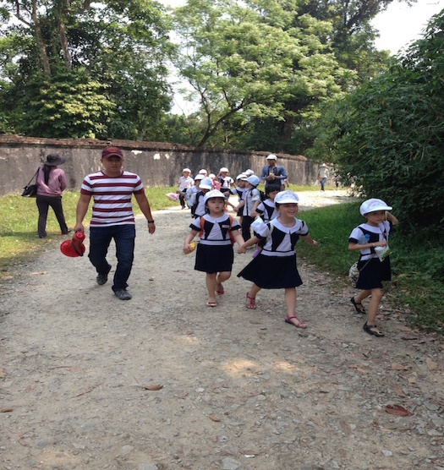
Education System
Preschool is optional for children under six, however all children between 6 and 11 must go to primary school.
Elementary education (primary school) lasts five years (grades 1 to 5, ages 6 - 11).
Lower Secondary Education (middle school) lasts 4 years (grades 6 to 9, ages 11 – 15).
Upper secondary education (high school): Most children move to high school at 15. It lasts three years (grades 10 to 12, ages 15-18).

Slide 6
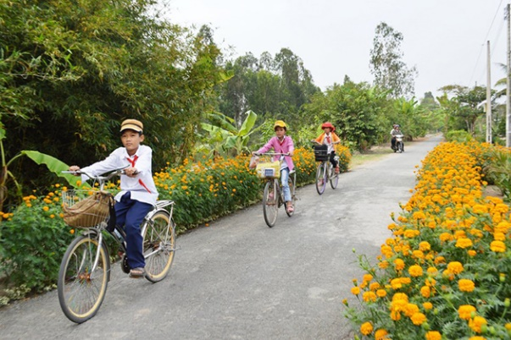
Schools are not well equipped, and often overcrowded (Some students go to school in the morning; Other goes to school in the afternoons)
Teachers frequently emphasis more on discipline in the schoolroom than on active interaction and discussions.
Teachers try to give as much knowledge as possible to students, but not skills and ways of thinking

Slide 7
OUT-OF-SCHOOL CHILDREN
There is about 7% children don’t have opportunity to go to primary and lower secondary schools.
The out-of-primary school rate was 6,7%; out-of-lower-secondary school rate was 8.1% (Source: MOET, 2017). Out of school children often live in very poor conditions or lack of one or both parents.

Slide 8
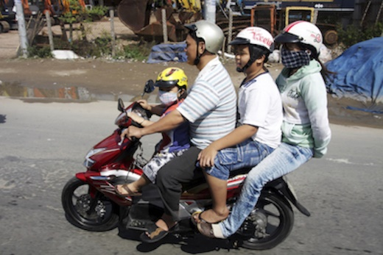
Everyday life
Grandparents help look after the small kids.
Kids older than 6 go to school.
Parents work hard.
In Vietnam, people in families often help each other.
Towns and cities are very crowded and most people live in small apartments.
Many Vietnamese people live in the country in small towns and villages.

Slide 9
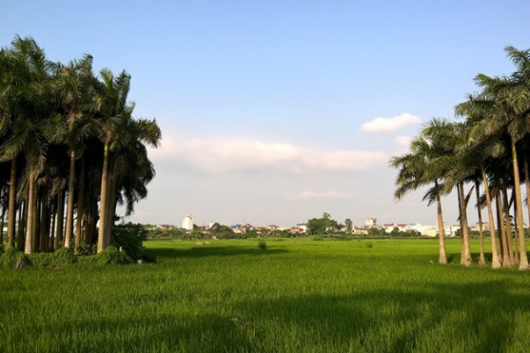
Majority of the population living in rural areas and working in the paddy fields.
Nowadays, many young people move to the big cities to work with the hope of larger income.
Middle adults often choose to work in the suburbs, where they can live near their house and families.

Slide 10
Some problems and Child Polices
A UNICEF report in 2015 showed that nearly 75% of children aged 2-14 in Vietnam have been violently abused by parents, caretakers, or other family members at least once (Source: GSO, 2015).
Many left behind children in rural areas, who live with grandparents or relatives, while their parents work far away.
Violent punishment (1-14 years): 68%
Child labour (5-17 years): 16%

Slide 11
1.2 Sampling strategy and outcomes
Geographically, the North Vietnam can be divided into two regions: Red River Delta; Northern Midland and Mountain, so we choose the provinces from these two regions.
8 year-old children in the 3rd grade
10 year-old children in the 5th grade
12 year-old children in the 7th grade
Each age group’s total sample size was set at about 1.000.
(1) The Red River Delta comprises 10 provinces and cities: Thai Binh, Nam Dinh, Ha Noi, Ninh Binh, Ha Nam, Bac Ninh, Hung Yen, Vinh Phuc, Hai Duong, Hai Phong. Population 20.439.400, in which number of children from 0 - 14 y/o contributes 22,7% (about 463.974.380 children) (Statistics, 2015)
(2) The Northern Midland and Mountain areas includes 15 provinces: Lao Cai, Lai Chau, Dien Bien, Son La, Hoa Binh, Yen Bai, Ha Giang, Cao Bang, Bac Kan, Thai Nguyen, Lang Son, Tuyen Quang, Bac Giang, Phu Tho, Quang Ninh. Population 11.508.100, in which number of children from 0 - 14 y/o contributes 26,5% (about 304.964.650 children) (Statistics, 2015)

Slide 12
The primary sampling unit was provinces and areas.
First, we choose randomly 3 provinces in the Red River Delta (Vinh Phuc, Ha Noi, Ha Nam) and 4 provinces in the Northern Midland and Mountain (Son La, Bac Giang, Thai Nguyen, Quang Ninh).
The urban, rural, and mountainous areas (depend on geographical characteristics of each province) are identified as the first sampling strata.
There are 14 strata representing geographical regions of the North Vietnam, including:
(1) Hanoi - urban, (2) Hanoi - rural, (3) Ha Nam - urban, (4) Ha Nam - rural, (5) Vinh Phuc - urban, (6) Vinh Phuc - rural (belong Region Red River Delta);
(7) Thai Nguyen - Urban, (8) Thai Nguyen - rural, (9) Son La - urban, (10) Son La - mountain; (11) Bac Giang - urban, (12) Bac Giang - rural, (13) Quang Ninh - urban, (14) Quang Ninh – mountain (belong Region Northern Midland and Mountain).

Slide 13
Second, a list of public schools of each stratum was completed.
Third, schools were selected with uniform probability within each stratum from the list.
Fourth, within each school one or two, or three class groups was randomly selected with uniform probability. The number of class groups depends on the estimated class group size, which is different in every school and every area. For example one class in mountainous areas may have only 9 pupils, while one class in urban areas of big cities may have more than 50 pupils.
There was no requirement of parental consent for children to participate in the survey in Vietnam. However school rector board consent required for children to participate in the survey.
The survey was administered by researchers, university students, and school teachers. The group survey, using pen and paper, was conducted in all school classes.
The survey began in early 2018 and was completed by September 2018.
The number of participants was bigger, however some schools don’t give the consent for using the data in this project, so there is a lack of the data from some schools and areas.

Slide 14
Table 1 shows the resulting sample by stratum. There are a total of 2991 children in the study sample with 1.008 in the 8 year old group, 1.012 in the 10 year old group, and 1.091 in the 12 year old group.
Table 1: The sample by stratum (Numbers)
 | All | 1 | 2 | 3 | 4 | 5 | 6 | 7 | 8 | 9 | 10 | 11 | 12 | 13 | 14
8 y.o | 948 | 145 | 63 | 120 | 89 | 104 | - | 100 | - | - | 124 | 111 | - | - | 92
10 y.o | 952 | 179 | 66 | 109 | 79 | 96 | - | 110 | - | - | 116 | 107 | - | - | 90
12 y.o | 1.091 | 168 | 66 | 126 | 113 | 123 | 60 | 125 | - | - | 117 | 95 | - | - | 98
Total | 2.991 | 492 | 195 | 355 | 281 | 323 | 60 | 335 | - | - | 357 | 313 | - | - | 280

Slide 15
After data cleaning, the real number of participants as follow:
Table 2: Achieved sample by stratum (Numbers)
 | All | 1 | 2 | 3 | 4 | 5 | 6 | 7 | 8 | 9 | 10 | 11 | 12 | 13 | 14
8 y.o | 930 | 142 | 62 | 117 | 89 | 103 | - | 97 | - | - | 120 | 109 | - | - | 91
10 y.o | 946 | 177 | 66 | 107 | 79 | 96 | - | 108 | - | - | 116 | 107 | - | - | 90
12 y.o | 1.080 | 166 | 66 | 124 | 112 | 123 | 60 | 123 | - | - | 115 | 94 | - | - | 97
Total | 2.956 | 485 | 194 | 348 | 280 | 322 | 60 | 328 | - | - | 351 | 310 | - | - | 278

Slide 16
SOME RESULTS
The participants
Age and gender
The children’s ages ranged from 8 to 12 year-olds. About 46.5% of the sample are girls.
Country of birth
The study finds that about 2% of the children in the sample were not born in Vietnam
Table 3: Age by gender (numbers)
 | 8 year-old | 10 year-old | 12 year-old | Total
Boy | 478 | 496 | 578 | 1552
Girl | 435 | 444 | 497 | 1376
Missing | 17 | 6 | 5 | 28
Total | 930 | 946 | 1080 | 2956

Slide 17
Your home and the people you live with
Children aged 10 and 12 were asked “Which of the following best describes the home you live in?”
Most of the children (95.2%) lived with their family, while 1.4% lived in a foster home, 0.2% lived in children home. Only 2.2% of children answered they were living in another type of home (grandparents or relatives home, children in institutions, …).
Table 4: The home type that children live in (10 & 12 year-old) (%)
 | 10 year-old | 12 year-old | Total
I live with my family | 903 | 1027 | 1930
I live in a foster home | 19 | 17 | 36
I live in a children’s home | 3 | 2 | 5
I live in another type of home | 17 | 27 | 44
Missing | 5 | 7 | 12
 | 946 | 1080 | 2026

Slide 18
Table 5. Number of brothers and sisters children have (including step brothers and step sisters)
 | 0 | 1 | 2 | 3 | 4 | 5 | 6 | 7 | 8 | 9 | 10 | 11 | 12 | 13
10 y.o | 47 | 478 | 232 | 85 | 45 | 26 | 13 | 7 | 1 |  |  |  | 1
12 y.o | 51 | 538 | 246 | 133 | 49 | 22 | 10 | 5 | 7 | 2 | 2 | 1 |  | 1
M 10 = 1.77 (SD = 1.32)
M 12 = 1.83 (SD = 1.43)

Slide 19
Table 6. Parents live or work away from home for more than a month in the last year (10 & 12 year-old)
 | No | Yes, in another part of Vietnam | Yes, in a different country | Missing
Mother | 1743 (85.3%) | 265 (13%) | 3 (0.1%) | 32 (1.6%)
Father | 1587 (77.7%) | 402 (19.7%) | 8 (0.4%) | 46 (2.3%)

Slide 20
How satisfied are you with the people that you live with?
Children aged 8 were asked to rate their satisfaction with the people they live with using a five point emoticons scale, which was transformed into a scale ranging from zero to four.
Table 7: Satisfaction with the people you live with (8 year-old) (n, %) N = 948
M (SD) | Very unhappy | Unhappy | Middle | Happy | Very happy | Missing
 | 0 | 1 | 2 | 3 | 4
3.40 (0.73) | 6 (0.6%) | 10 (1.1%) | 71 (7.5%) | 365 (38.5) | 480 (50.6%) | 16 (1.7%)

Slide 21
Children aged 10 and 12 were asked the same questions using an 11-point scale ranging from zero to 10.
Table 8: Satisfaction with the people you live with (10, 12 year-old) (n, %) N = 2026
Not at all satisfied Totally satisfied
0 | 1 | 2 | 3 | 4 | 5 | 6 | 7 | 8 | 9 | 10 | Missing | M (SD)
14 (0.7) | 14 (0.7) | 24 (1.2) | 18 (0.9) | 185 (9.1) | 121 (6.0) | 65 (3.2) | 127 (6.3) | 232 (11.5) | 354 (17.5) | 846 (41.8) | 26 (1.3) | 8.12 (2.35)

Slide 22
Some differences in their satisfaction with people they live with were found by age, 10 year-old children were more satisfied than 12 year-old children
Table 9. Differences in satisfaction with people children live with by age (N = 2000)
 | M | SD | p
10 year–old (n = 938) | 8.36 | 2.30 | 0.000
12 year–old (n = 1062) | 7.91 | 2.37

Slide 23
All age groups of children were asked about their views on their family and people in their family. Children were asked to rate their agreement with follow statements, using a 5-point scale
(0: I do not agree, 1: I agree a little, 2: I agree somewhat, 3: I agree a lot, 4: I totally agree).
Table 10. Children views on their family and people in their family
 | 8 | 10 | 12 | p
There are people in my family who care about me | 3.43 (1.00) | 3.54 (0.91) | 3.44 (0.96) | 0.02
If I have a problem, people in my family will help me | 3.27 (1.04) | 3.43 (0.93) | 3.32 (1.04) | 0.01
We have a good time together in my family | 3.22 (1.14) | 3.29 (1.05) | 3.21 (1.10) | 0.09
I feel safe at home | 3.14 (1.21) | 3.30 (1.10) | 3.41 (1.04) | 0.03
My parents listen to me and take what I say into account | 2.96 (1.27) | 2.96 (1.24) | 2.70 (1.34) | 0.00
My parents and I make decisions about my life together |  | 2.88 (1.34) | 2.62 (1.44) | 0.00

Slide 24
2.3. Overall subjective well-being
The Children’s Worlds survey included a variety of different measures asking about overall subjective well-being
  OLS (Overall Life Satisfaction) – One question about satisfaction with life as a whole
  CW-SWBS (Children’s Worlds Subjective Well-Being Scale) – 6 items measuring cognitive
  subjective well-being (Based on the Student Life Satisfaction Scale by Huebner, 1991).
  CW-DBSWBS (Children’s Worlds Domain Based Subjective Well-Being Scale) – 5 items
  measuring domain based cognitive subjective well-being (based on the Brief Multidimensional
  Student Life Satisfaction Scale by Seligson, Huebner & Valois, 2003).
  CW-PNAS (Children’s Worlds Positive and Negative Affect Scale) – 6 items measuring affective
  subjective well-being: positive and negative affect (based on Barrett & Russell, 1998).
  CW-PWBS (Children’s Worlds Psychological Well-Being Scale) – 6 items measuring
  psychological subjective well-being (based on Ryff, 1989)

Slide 25
Overall life satisfaction (OLS)
Children who are 10 and 12 year-olds are asked to rate their overall life satisfaction ('life as a whole') using an 11-point scale, and children who are 8 year-olds are asked to use a 5-point emoticons scale. The distribution of each levels is shown in table … On life as a whole, 45.6% of 10 and 12 year-olds were totally satisfied with their life, and 60.6% of 8 year-olds score maximum on the overall life satisfaction scale.
Table 11. Overall life satisfaction (10 & 12 year-old, n = 2043) (%)
 | 0 | 1 | 2 | 3 | 4 | 5 | 6 | 7 | 8 | 9 | 10
Vietnam 2018 | 1.4 | 0.6 | 0.7 | 1.1 | 1.4 | 5.3 | 3.5 | 6.8 | 12.6 | 21.1 | 45.6
Korea 2016 | 0.8 | 0.6 | 1.2 | 1.8 | 3.1 | 8.3 | 5.8 | 10.1 | 14.2 | 15.2 | 39.1

Slide 26
Table 12. Overall life satisfaction (8 year-old, n = 948) (%)
 | 0 | 1 | 2 | 3 | 4
Vietnam 2018 | 2.2 | 2.4 | 13.9 | 32.2 | 49.2
Korea 2016 | 1.7 | 3.0 | 9.4 | 25.4 | 60.6

Slide 27
Table 13. CW-SWBS (Children’s Worlds Subjective Well-Being Scale)
How you feel about life as whole | 8 year-old (948) |  | 10 year-old (942) |  | 12 year-old (1078) |  | p
 | M | SD | M | SD | M | SD
I enjoy my life | 3.34 | 0.88 | 8.21 | 2.42 | 7.48 | 2.56 | 0.000
My life is going well | 3.19 | 0.93 | 8.29 | 2.36 | 8.08 | 2.33 | 0.040
I have a good life | 3.35 | 0.91 | 8.33 | 2.41 | 7.74 | 2.60 | 0.000
The things that happen in my life are excellent | 3.12 | 1.02 | 7.62 | 2.67 | 6.77 | 2.84 | 0.000
I like my life | 3.38 | 0.90 | 8.43 | 2.41 | 7.68 | 2.62 | 0.000
I am happy with my life | 3.40 | 0.91 | 8.51 | 3.54 | 7.72 | 2.67 | 0.000
CW-SWBS | 82.54 | 16.95 | 82.62 | 20.83 | 76.00 | 22.56 | 0.000

Slide 28
Table 14. CW-DBSWBS (Children’s Worlds Domain Based Subjective Well-Being Scale)
How satisfied are you with: | 8 year-old (948) |  | 10 year-old (942) |  | 12 year-old (1078) |  | p
 | M | SD | M | SD | M | SD
The people you live with | 3.40 | .731 | 8.37 | 2.30 | 7.90 | 2.39 | 0.000
Your friends | 3.22 | .855 | 7.44 | 2.52 | 7.34 | 2.52 | 0.342
Your life as a student | 3.32 | .786 | 8.40 | 2.10 | 7.94 | 2.29 | 0.000
The area where you live | 3.48 | .809 | 8.48 | 2.11 | 7.67 | 2.49 | 0.000
The way that you look | 3.10 | 1.018 | 7.96 | 2.40 | 7.52 | 2.47 | 0.000
CW-DBSWBS | 82.62 | 13.74 | 81.22 | 16.47 | 76.91 | 16.74 | 0.000

Slide 29
Table 15. Personal Well-being Index – School Children (PWI-SC7)
How satisfied are you with: | 8 year-old (948) |  | 10 year-old (942) |  | 12 year-old (1078) |  | p
 | M | SD | M | SD | M | SD
How safe you feel | 3.15 | 0.96 | 8.21 | 2.25 | 7.85 | 2.38 | 0.000
The freedom you have | - |  | 7.82 | 2.61 | 7.37 | 2.65 | 0.000
The way that you look | 3.10 | 1.01 | 7.96 | 2.40 | 7.52 | 2.47 | 0.000
What may happen later in your life | - |  | 7.32 | 2.85 | 7.13 | 2.69 | 0.118
How you are listened to by adults in general | - |  | 8.23 | 2.41 | 7.45 | 2.74 | 0.000
Your health | 3.24 | 1.02 | 8.54 | 2.18 | 8.20 | 2.29 | 0.001
Your life as a whole | 3.24 | 0.93 | 8.81 | 1.91 | 8.28 | 2.20 | 0.000
PWI_7 | 79.55 | 16.91 | 81.58 | 16.35 | 77.13 | 17.07 | 0.000

Slide 30
Boy feel safe more than girl (n = 2010, 10-12 y/o)
How satisfied are you with: | Boy |  | Girl |  | p
 | M | SD | M | SD | p
How safe you feel | 8.12 | 2.35 | 7.89 | 2.29 | 0.025

Slide 31
Table 16. Variations in different measures of subjective well-being (8, 10 & 12 year-old) (Means)
 | 8 year-old (948) |  | 10 year-old (942) |  | 12 year-old (1078) |  | p
 | M | SD | M | SD | M | SD
SWBS | 82.54 | 16.95 | 82.45 | 20.24 | 76.0097 | 22.56 | 0.000
DBSWBS | 82.62 | 13.74 | 81.22 | 16.47 | 76.91 | 16.74 | 0.000
PWI | 79.55 | 16.91 | 81.58 | 16.35 | 77.13 | 17.07 | 0.000
PAS |  |  | 81.11 | 18.60 | 75.43 | 20.18 | 0.000
NAS |  |  | 42.36 | 27.59 | 46.12 | 27.53 | 0.003

Slide 32
Table 17. 8 y/o children
 | Never | Sometimes | Often | Always | Don’t know
Last two weeks: How often feeling happy | 3.8 | 14.9 | 17.3 | 45.0 | 19
Last two weeks: How often feeling sad | 42.2 | 36.2 | 9.6 | 7.7 | 2.4

Slide 33
Variations in subjective well-being
Table 18. Variations in different areas of subjective well-being (10 & 12 year-old) (Means)
 | Urban 1019 |  | Rural 543 |  | Mountain 481 |  | F | p
 | M | SD | M | SD | M | SD
SWBS | 82.12 | 21.05 | 81.78 | 20.49 | 68.78 | 21.65 | 66.984 | .000
DBSWBS | 82.02 | 15.28 | 80.73 | 16.14 | 69.85 | 17.72 | 91.280 | .000
PWI_7 | 81.17 | 17.17 | 80.16 | 17.33 | 73.57 | 14.30 | 32.479 | .000
PAS | 78.64 | 20.04 | 78.02 | 20.30 | 76.86 | 17.96 | 1.271 | .281
NAS | 47.16 | 28.54 | 44.19 | 26.15 | 38.38 | 26.27 | 15.877 | .000

Slide 34
Table 19. Satisfaction with different aspects of life (10, 12 year-old) (Mean and SD)
Satisfaction with: | 10 year-old |  | 12 year-old |  | p
 | M | SD | M | SD
Things you have learned | 8.83 | 1.91 | 8.26 | 2.11 | 0.000
Your life as a whole | 8.81 | 1.91 | 8.28 | 2.20 | 0.000
Your health | 8.54 | 2.18 | 8.20 | 2.29 | 0.001
All the things you have | 8.49 | 2.20 | 7.92 | 2.30 | 0.000
The area where you live | 8.48 | 2.11 | 7.67 | 2.49 | 0.000
Your life as a student | 8.40 | 2.10 | 7.94 | 2.29 | 0.000
The people you live with | 8.37 | 2.30 | 7.90 | 2.39 | 0.000
How you are listened to by adults in general | 8.23 | 2.41 | 7.45 | 2.74 | 0.000
How you use your time | 8.23 | 2.20 | 7.69 | 2.36 | 0.000
How safe you feel | 8.21 | 2.25 | 7.85 | 2.38 | 0.000
How much free time you have | 8.00 | 2.50 | 7.44 | 2.66 | 0.000
The way that you look | 7.96 | 2.40 | 7.52 | 2.47 | 0.000
The freedom you have | 7.82 | 2.61 | 7.37 | 2.65 | 0.000
Other children in your class | 7.65 | 2.41 | 7.21 | 2.48 | 0.000
Your friends | 7.44 | 2.52 | 7.34 | 2.52 | 0.342
What may happen to you later in your life | 7.32 | 2.85 | 7.13 | 2.69 | 0.118

Slide 35
CW-PWBS (Children’s Worlds Psychological Well-Being Scale)
In 12-years-old survey
Table 20. Psychological Well-Being of 12 year-old children (n = 1080)
How much you agree with following: | M | SD
I like being the way I am | 7.84 | 2.64
I am good at managing my daily responsibilities | 6.84 | 2.90
People are generally pretty friendly towards me | 7.77 | 2.42
I have enough choice about how I spend my time | 7.25 | 2.88
I feel that I am learning a lot at the moment | 7.97 | 2.45
I feel positive about my future | 7.42 | 2.89
PWBS (Psychological Well-Being Scale) | 75.07 | 19.42

Slide 36
3. Conclusions
The findings on children’s subjective well-being show that:
- Most children (about 80%) aged 8 to 12 in Vietnam are relatively satisfied and happy with their lives. On life as a whole, about 45.6% of the 10 and 12 year-olds and 49.2% of the 8 year-olds were totally satisfied with their life.
- There are some differences in children’s well-being responses by age group and area. When asked about various aspects of their home and family, the level of positive response was the lowest among the older age group (age 12). Children living in mountain and rural areas have lower subjective well-being than children living in urban area.
- Children less satisfy with the freedom they have, other children in their class, their friends, and what may happen to them later in their life

